Slide 1
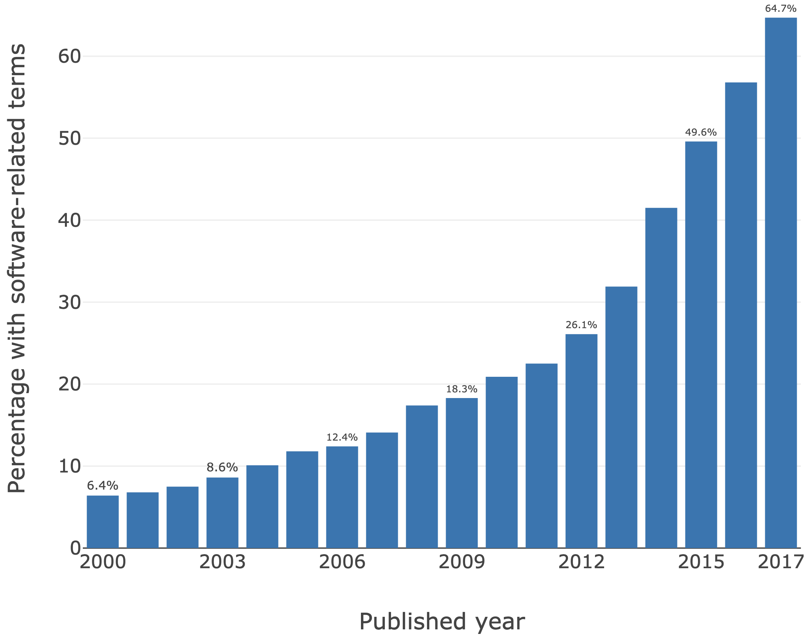
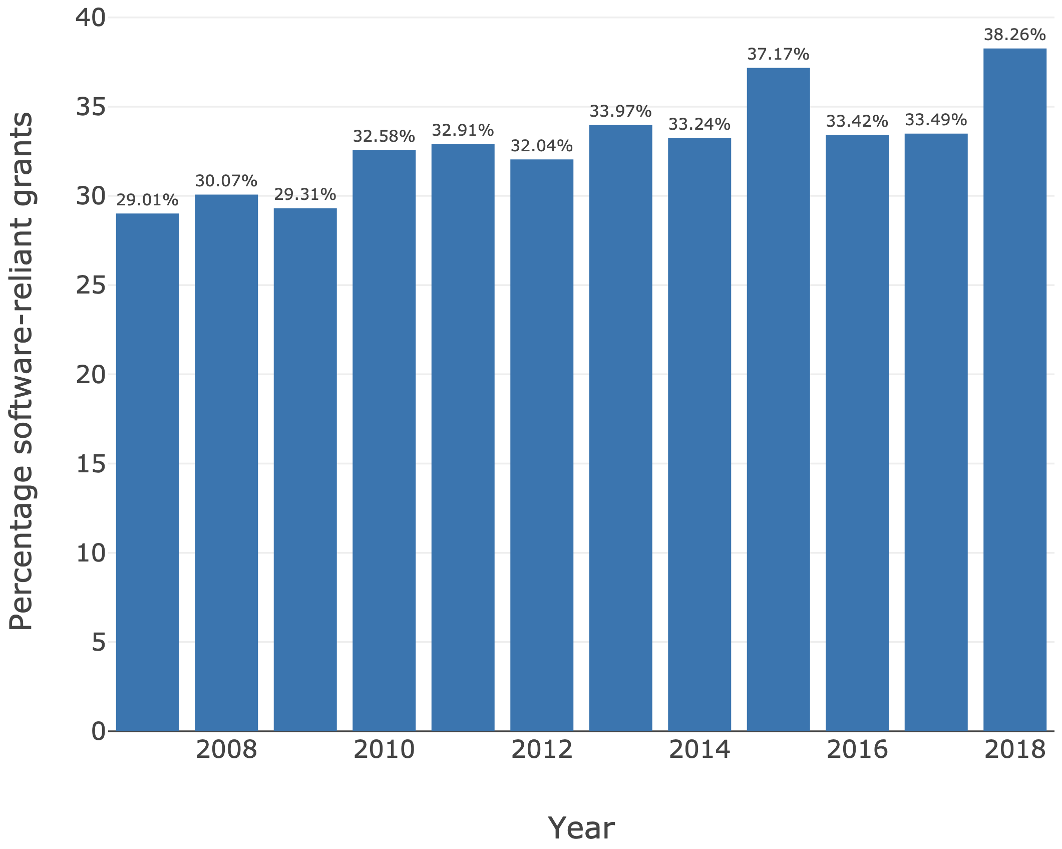
Why should we care about software?
[2]
Notes:
And the evidence of software in research is increasing…
From analyses also conducted by the Institute, we can also see an exponential increase in software-related terms used in publications, and an increase in those terms used in software-reliant grants in the UK.

Slide 2
A typical research software lifecycle
Research Questions
Develop Software
Run Software
Analyse Data
Publish Paper
Project Ends
Notes:
Your mileage may vary, but...
This is typically how a typical research software lifecycle is viewed
Nice and tidy
Obvious when you should transition to the next stage
It's great.
And that's how it happens every time, right?

Slide 3
A typical research software lifecycle - in reality
What happens when…
You have a follow-on project?
Someone else wants to use your code?
Someone wants to reproduce your results?
Research Questions
Develop Software
Project Partners
Run Software
Industry
Analyse Data
Graceful Decline
Publish Paper
Other People
Project Ends
When should you have considered how to engineer your software?
Notes:
Is a typical research lifecycle a waterfall? Nope.
It's rarely that simple in practice
And there are a number of reasons for this
You often find that a group has been building on the same project for years, adding more complexity
The research questions change
The design of a key algorithm needs changing, leading to a need to change the implementation
A mistake is found during data analysis and a bug needs to be fixed pronto
And what happens when a follow-on project crops up, perhaps some time later?
How about other collaborators come on board an existing project?
Someone wants to reproduce your results by running your software themselves?
Also: very few people plan for their project to decline gracefully, as it's utility ends and becomes superceded
You probably don’t want it to decline - but it will given enough time - so a good idea to consider this aspect
We're not even considering integration with other software as as a required part of a collaboration
Far more complicated!

Slide 4
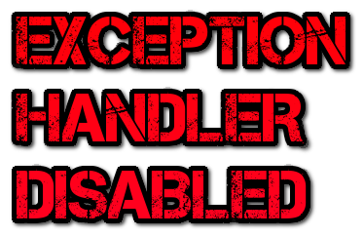


What could go wrong?
Ariane 5
$7B development $500 milion rocket
Used Ariane 4 code
Loss of guidance & altitude info
64-bit FP converted to 16-bit signed integer
Notes:
Even heavily engineered projects get it wrong.
Here's an example: the Ariane 5 rocket.
$7B development
$500 milion rocket
Used Ariane 4 code - a good thing right? Reusing code?
Problem was ultimately caused an arithmetic overflow. Why wasn't this caught?
An exception in the code that dealt with this situation was disabled.
Truly spectacular failure. Could have been caught during:
Requirements
Design
Reuse of Ariane 4 code
Testing?

Slide 5
Where are you?
Researcher
Software Engineering
Research
Software Engineer
Researcher developer
Notes:
Consider this scale: software engineering at one end, pure research on the other...
How far towards software engineering should you go?
Where do you see yourself on this scale?
And importantly: how far should you go?
Can always learn new skills
But research pays the bills
Limited time - can't do everything!
So there is a tradeoff.
But some core skills, such as those taught in this course, can add to your skills toolbox
And really make a difference
Can always learn more SE skills later!

Slide 6
What's the story?
RSE community - and demands on it - is growing
Need for further upskilling
Clear gaps in training provision
May 2020 - Institute develops new intermediate course
Previous initiatives pointed to key upskilling areas
Taking into account training delivery constraints
March, April, July 2021 - internal and external pilots
July - October 2021 - refinement, Carpentry Incubator
Dec 2021 - refinement, move to beta
Beyond - academic & industrial workshops, general reuse
Pre-alpha
Alpha
Beta - stable
Notes:
So let's have a look at where this course came from...
So what's motivated this course, what's happened so far with it, and where is it going?
A bit of background
The Research Software Engineering community - within the UK and abroad - is growing
- Where an RSE is someone who writes research software - very likely yourselves
- And the demands on RSEs as the needs and complexity of research software continue to increase
- Training conducted by initiatives such as the Carpentries, community surveys conducted by the Institute, Institute consultancy projects, collaborations with others - all point to the same thing
- That the community is in need of further upskilling, and that there's a gap in training curricula and courses
- Particularly in the area of software development skills within collaborative teams
- Initiatives like the Carpentries have done an exceptional job of upskilling the community with foundational computational and data management skills
- But what comes after that?
- In a way, we're faced with a similar situation we had previously, before training like the Carpentry courses came along
So back in May last year, the Institute commissioned the development of this intermediate course
- Many of our other training, consultancy, and collaborative activities had pointed quite firmly at what those topics should be
- That is, beyond novice skills
- And the pandemic last year meant we were also driven to explore new ways of delivering training online
- And this all came together to shape the course we now have currently
- So development progressed throughout 2020
Then in March & April 2021 we had two internal pilots and one external pilot of the material
Following further refinement we placed it into the Carpentry incubator
- A place for Carpentry-style training material to be shared (at any stage of development)
- To raise the profile of lessons in development, attract new collaborators, get feedback, and so on
- Seeing lots of third-party interest in reusing material in own workshops
- We're working with other academic and industrial groups on future training events in 2022
- So this is a critical time
- As well as helping you to learn some useful skills, this event and your feedback is integral to improving it
- The idea is that anyone can reuse these materials for their own training or other purposes
- And also take them and modify them under the Creative Commons BY v4.0 license
- If you do use them yourselves, for any reason, please let us know of your experiences!

Slide 7
Zoom etiquette & instructions
Rename yourselves to use at least your first name
Mute yourselves unless speaking & share video if you like
If you need to step out at any time, please feel free to do so!
Main Zoom room
Zoom Reactions (yes/no indicators) - to get feedback from you about your progress when in main Zoom room
Ask questions at any time!
Breakout rooms
Organised into groups of 5 or 6 learners with 1-2 helpers
Get to know and ask others in your Zoom group
Please ask for help - do not suffer in silence!
Come to main room and ask for help if needed!
Notes:
And lastly, here are a few points of etiquette about the tools we'll be using throughout the workshop
For Zoom,
- Please rename yourselves to use at least your first name
- And if you would like, please feel free to add your personal pronouns as well
- You can do that by selecting the 'Participants' tab on the Zoom navigation bar at the bottom
- Hovering over your name and clicking on 'More', then selecting 'Rename'
- You'll also notice a mute option if you hover over your name as well
- And it would be great to please mute yourselves if not talking
And of course, if you need to step out at any time, please feel free to do so!
There's a couple of locations we'll be undertaking training for this course
The first is in the main Zoom room (this room)
- Used for morning and afternoon Q&A sessions - help you with any problems, introduce upcoming topics
- We may sometimes ask you to use Zoom reactions in response to questions
- As we mentioned previously, to do that select 'Reactions' at the bottom of the Zoom navigation bar to access them
- Please ask questions at any time
Zoom breakout rooms
- You'll be rooms of about 5 or 6
- Work through the learning materials on your own, or in groups for the last day
- We encourage talking about the material and asking others for help if you run into problems
There will be 1 or 2 helpers in each Zoom room if you run into issues
- But in the first instance, you can ask others in your group if you like, so please get to know others in your group too
- If there's a lot of discussion going on, or lots of people asking for help - and you still need help
- Please feel free to join the main room and ask for help there

Slide 8

Intermediate Research Software Development in Python
25th and 26th of November 2024
Slides borrowed from Aleksandra Nenadic,
UK Software Sustainability Institute

Slide 9
Introduction
What is this course about?
Why should I consider how I engineer my projects?
How is this course organized?

Slide 10
What is this course about?

Slide 11
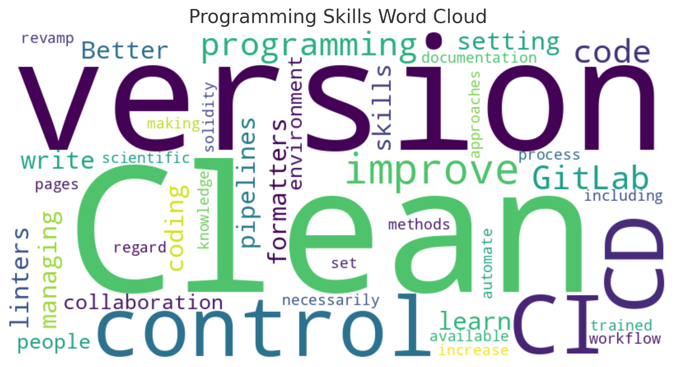
What is this course about?

Slide 12
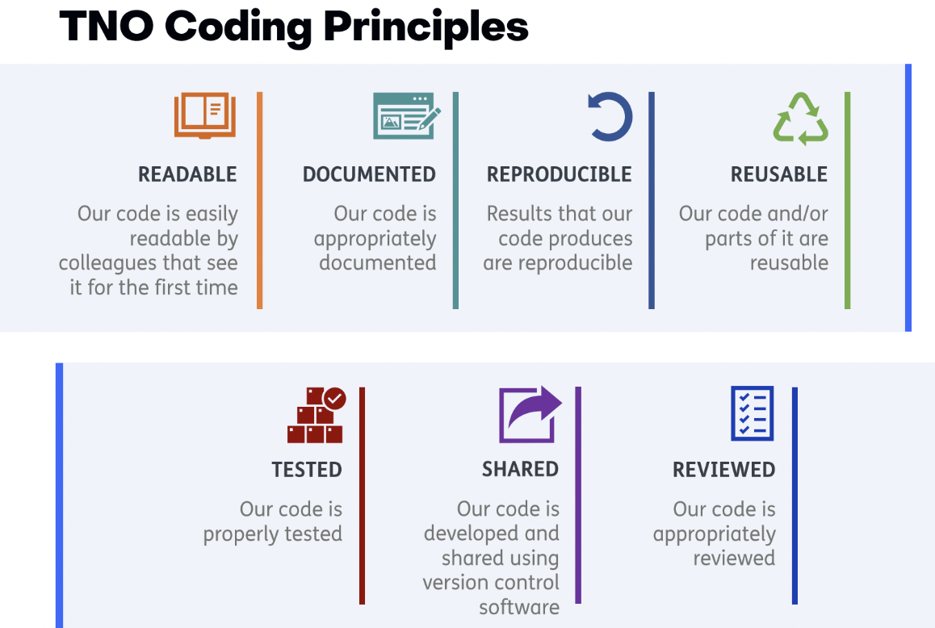

Slide 13

Modern research is impossible without software
From thrown-together scripts, through an abundance of complex spreadsheets, to the millions of lines of code behind large-scale infrastructure, there are few areas where software does not play a fundamental part in research
Notes:
A bit on the motivation for this course
From social science, to climate analysis, to biomedical science, to particle physics
the development of software used as part of the research process is only increasing. And in your own domains as you are fully aware as you would not be here otherwise.
And that software includes your software - the software you write, not just the software you use.
You are the ones who build the software that makes the magic happen.
After all, it's the software you write that generates results that advances the science. And we consider code to be anything from a formula in a spreadsheet to 100s lines of code.

Slide 14
What is this course about?
Design & engineer robust, extensible and reusable software through the application of suitable programming paradigms and design techniques in a team environment and in collaboration with others
Use a critical, reflective mindset to assess, improve, prepare and release your software for reuse by others
Manage software project over its lifetime and its improvement from feedback through agile techniques
Research is an increasingly collaborative endeavor that heavily relies on software - such software must be robust and reliable
Notes:
What are our goals for this course? Research is an increasingly collaborative endeavor that heavily relies on software - such software must be robust and reliable.
The course teaches intermediate software engineering skills to help you design more robust software that goes beyond a few thrown-together proof-of-concept scripts, taking into consideration the lifecycle of software, writing software for stakeholders, team ethic and applying a process to understanding, designing, building, releasing, and maintaining software over its lifetime.
We will present you a set of core best practices that you can adopt within your software development team that will help you write robust, reusable and maintainable code - this core set of skills we teach is not an all-encompassing set of skills, but a selective set of tried-and-tested collaborative development skills that forms a firm foundation for continuing on your learning journey.

Slide 15
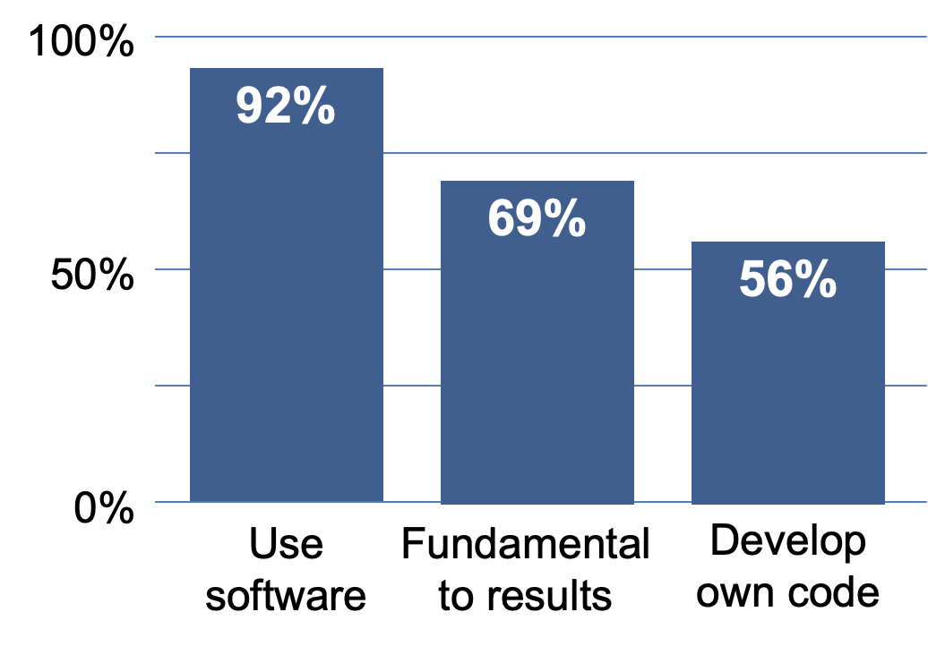
Why should we care about software we write?
SSI survey of researchers, 2014 DOI:10.5281/zenodo.1183562
15 Russell Group Universities
Their software use and background
417 respondents
Notes:
Back in 2014 the Software Sustainability Institute conducted a survey of researchers at 15 Russell Group universities in 2014, To find out about their software use and background.
417 respondents - 92% of researchers said they use software in their research, - and 69% that it’s fundamental to their results, - and over half of their time is spent developing code (worryingly, 21% of those have no training in software development)
That's a significant proportion developing their own code!

Slide 16
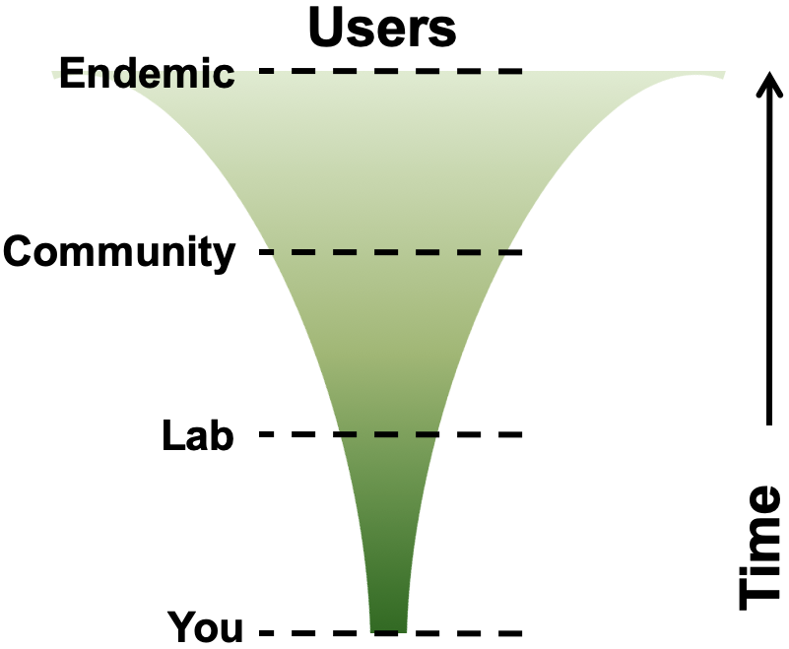
The software you write is important!
Software inherently contains value, not a throw-away artifact
Difficult to gauge to what extent it might be used in the future
By who?
Which parts?
Which projects?
Reproducibility of results – from publications!
Can it/should it be reusable by others?
...including yourself?
Notes:
Traditionally in academia, perhaps not in industry, software is often seen as a necessary but a throwaway artefact in research.
But this is changing and we are advocating for making software a prime output and first class citizen in research.
Software inherently contains value
It produces results, and contains lessons learnt, and represents effort
So you need to protect your investment!
Once written, it's difficult to gauge to what extent it might be used in the future
By who? Which parts? Which projects?
You may find it would be great to use it for a follow-on or unrelated project:
Hang on a minute, we already solved that technical problem, let’s use this… you may find out you created a solution to a problem causing others big headaches
And that might be the whole of it, or just a part of it: in time, a part may turn out to be more valuable than the whole
You should not be reinventing the wheel - it is a waste of resources. Has someone else already solved this?
And also there are those who might want to reproduce results using your software and from publications.
Does the software enable them to do that?
Two key questions to ask are:
Can this software I'm writing be reusable by others? Including yourself!
A related second question is should this software I'm writing be reusable by others?
If it's a one-line simple script, maybe, maybe not
At the other end of the spectrum, if it's integral to producing the results, then I'd say yes!

Slide 17

When should you have considered how to engineer your software?
"The best time to plant a tree is 20 years ago. The second best time is now.”
Notes:
Which brings us to another question … at which point should you have considered how to engineer your software? At which point you cross a line between a proof of concept script that will never see the light of the day and something that may be of use to others.
Answer: ideally, before the project starts
But failing that, there's always something you can do now to improve the situation.
If you have not planned and engineered your software - it is not too late to start now.
Why do you need to engineer software properly and from the get go?
You often find that a group has been building on the same project for years, adding more complexity - then more follow up projects crop up that build on top of it
The research questions change - you want to be able to adapt quickly
The design of a key algorithm needs changing, leading to a need to change the implementation
A mistake is found during data analysis and a bug needs to be fixed pronto
Other collaborators come on board an existing project - you need to include them in the software development
Someone wants to reproduce your results by running your software themselves - are they able to do that?

Slide 18
Programming vs engineering
Programming / Coding
Focus is on one aspect of software development (implementation)
Writes software for themselves
Mostly an individual activity
Writes software to fulfil research goals (ideally from a design)
Engineering
Considers the lifecycle of software
Writes software for stakeholders
Takes team ethic into account
Applies a process to understanding, designing, building, releasing, and maintaining software
"Programmers tend to start coding right away. Sometimes this works." - Eric Larsen, 2018
Notes:
Programmer and Software Engineer often used interchangeably.
They are not. As a novice to coding - you may start to program or code. On a more intermediate level - you start to engineer your code.

Slide 19
Target audience
A researcher developer, with foundational coding skills, now facing new challenges
Software projects becoming more complex
Scale of development increasing
More collaborative development and use, internal or external
Higher expectations on software
Increase in requests for change, more 'technical debt'
Researcher
Software Engineering
Research
Software Engineer
Researcher developer
Notes:
So this is who we're targeting the course at… Hopefully you should be able to see yourselves in this

Slide 20
Course outline
Environment for Collaborative Code Development
Setting up our software project, development environments and tools, virtual environments, Git & GitHub, coding conventions
Ensuring Correctness of Software at Scale
Automatically testing your software, unit tests, continuous integration, debugging, improving code robustness
Software Development as a Process
Software requirements, design, architecture and implementation (via programming paradigms) as typical stages of a software development process
Collaborative Software Development for Reuse
Code review, documenting and preparing/packaging software for release and reuse
Managing and Improving Software Over Its Lifetime
Tracking issues, managing team communications and software project planning and management
Apply learned skills to own project

Slide 21
Course outline
Environment for Collaborative Code Development
Setting up our software project, development environments and tools, virtual environments, Git & GitLab, coding conventions
Ensuring Correctness of Software at Scale
Automatically testing your software, unit tests, continuous integration, debugging, improving code robustness
Software Development as a Process
Software requirements, design, architecture and implementation (via programming paradigms) as typical stages of a software development process
Collaborative Software Development for Reuse
Code review, documenting and preparing/packaging software for release and reuse

Slide 22
How will the workshop run
Delivery is helper-supported self-learning (no live coding)
Learners go through material individually (at their own pace)
You work together in groups of 3-4 people
Trainers will be available to assist with problems and answer questions
Initially exercises are performed individually, more group/team work in later stages when we will need to keep more in sync with everyone in a group
Feel free to ask questions and start discussions with people in your group or instructors. This is a good opportunity to ask related questions about your daily work as well.
Take regular breaks as you need

Slide 23
The rhythm
Roughly 1 section per half day
(but the first one will most likely take a bit longer)
Together we decide the speed 🏎🐌
We will adapt the moment of our instructions to how far you are in the lesson material
Temperature check 🌡
We will check how far everyone is right before every break
Recaps and discussion after the break
And at the end of the day

Slide 24
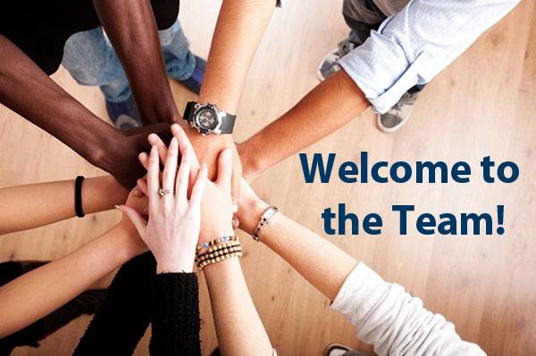
The story...
You have just joined a team that works on an existing software project. The project is written in Python and studies and analyses inflammation in a group of patients that have been given a new treatment for arthritis in a medical trial. The software project is not finished and contains some bugs and tests that are failing. Over the course - you will work either individually or with your colleagues to develop more code and fix these errors.
Notes:
So what is the story and what will you be doing in the first section? You have just joined a team that works on an existing software project. The projects is written in Python and studies and analyses inflammation in a group of patients that have been given a new treatment for arthritis in a medical trial. The software project is not finished and contains some bugs and tests that are failing. Over the course - you will work either individually or with your colleagues to develop more code and fix these errors.

Slide 25
A final note …
About working through the material
Start from the actual section introduction - bigger picture
Exercises - try to do them on your own (before looking at the solution)
Exercises - don't skip them! Some later materials depend on this
Optional exercises are clearly marked - all other exercises should be completed
Please ask for help - do not suffer in silence!
Ask for help if needed
We know from experience that some people don't like to read, especially not at the end of the day when you feel like everyone else is moving faster than you. Ask an instructor to explain instead of reading the texts!
Notes:
In-person
A quick point about the exercises…
Please try to do them on your own, at least first
Solutions are provided, but building an understanding is important, particularly in later stages
Plus later stage exercises give you more scope to be creative with your solutions
So be inventive! The later sections of the course get you to work in teams
And will be partially about looking at other teams' code, so the more different the better! We do have a contrived software project to work on - so there may not be that many differences.

Slide 26
A final note …
About working through the material
Start from the actual section introduction - bigger picture
Exercises - try to do them on your own (before looking at the solution)
Exercises - don't skip them! Some later materials depend on this
Optional exercises are clearly marked - all other exercises should be completed
Please finish the section in the rest of the week if you were note finished. Note that section 1 is a bit bigger than the other sections.
We wrap up together at the end of the day. If you finish the section early you can work on the optional exercises in the collaborative document
Please ask for help - do not suffer in silence!
Ask for help if needed
We know from experience that some people don't like to read, especially not at the end of the day when you feel like everyone else is moving faster than you. Ask an instructor to explain instead of reading the texts!
Notes:
A quick point about the exercises…
Please try to do them on your own, at least first
Solutions are provided, but building an understanding is important, particularly in later stages
Plus later stage exercises give you more scope to be creative with your solutions
So be inventive! The later sections of the course get you to work in teams
And will be partially about looking at other teams' code, so the more different the better! We do have a contrived software project to work on - so there may not be that many differences.

Slide 27
What questions do you have?
Let’s start!
Notes:
About the material or workshop operations?
Link to training material will be pasted in the chat
I’ll introduce the first day material briefly now…

Slide 28
Section 1: Setting Up Environment For Collaborative Code Development & Intro to Our Software Project
In order to develop (write, run, test, debug, backup) code efficiently, you need to use a number of different tools interchangeably
Introduction to software project and software development tools (refresher)
Command line, PyCharm IDE, Git + GitHub
Setting up virtual development environment to isolate code (pip, venv)
Writing and checking for well-formatted and readable code - PEP8 coding style convention & linting
“Anyone can write code that a computer can understand. Good programmers write code that humans can understand.” - Martin Fowler, a British software engineer, author and international speaker on software development
Notes:
In this section, you will familiarise yourself with the software project and learn the tools other members of the team are using. There is a number of tools that are used in conjunction for software development on this project and you need to set them all up on your machine and get used to using them all interchangeably as you would in a real-life team development setting.
For the purpose of this course, we selected a number of free and open source tools that we believe make a difference:
Command line tools to run the code, install dependencies and set up a virtual development environment
IDE PyCharm - a rich software development environment for developing, testing and debugging code.
Git to version control our code and GitHub to share it with the team and manage issues, communications and our software as a project
These tools are certainly not mandated in practice - you will often in practice have a choice of different similar tools - however for the purpose of this course we had to make a choice and hope that the knowledge you pick on here is transferable to other similar tools you may use in future.
Key message
In order to develop (write, test, debug, backup) code efficiently, you need to use a number of different tools interchangeably
Which tool is right for you which depends on personal preference or what the community you belong to is using - we only try to cover transferable concepts here
Link to materials: https://softwaresaved.github.io/az-intermediate-software-skills-course/index.html
Poll for software we needed to install:
Git Bash/Command line
Python
GitHub accounts
Python
oll

Slide 29
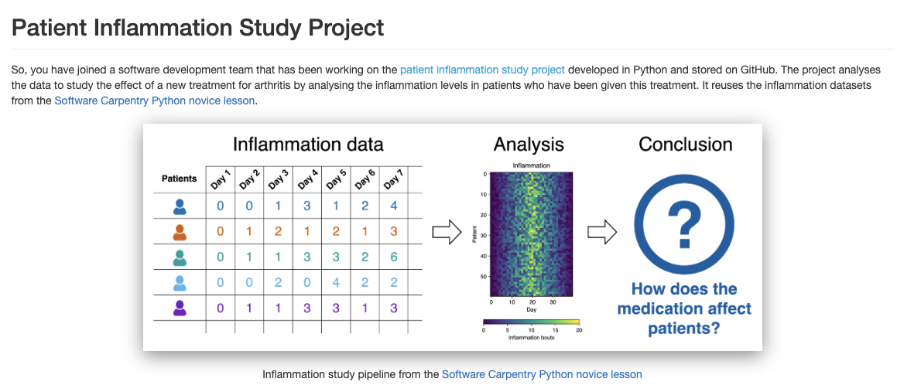

Slide 30
Recap

Slide 31
Model – View – Controller architecture
Model (represents the data)
View (interacts with the user), and
Controller (handles input and output).
Example:
I click on ‘summary of inflammation study results for these 10 patients’
Controller accepts this input and asks Model for the appropriate data
Model retrieves the data and sends it to Controller
Controller requests Model to compute stuff
The Controller sends the result to View
View presents the results

Slide 32
Model – View – Controller architecture
It makes sense to gather functionality that is related to each other in a module and make it clear how modules interact with each other (how they ‘interface’).
This makes the code more modular, and thereby more reusable, readable, and manageable. We will get back to this in section 3.

Slide 33
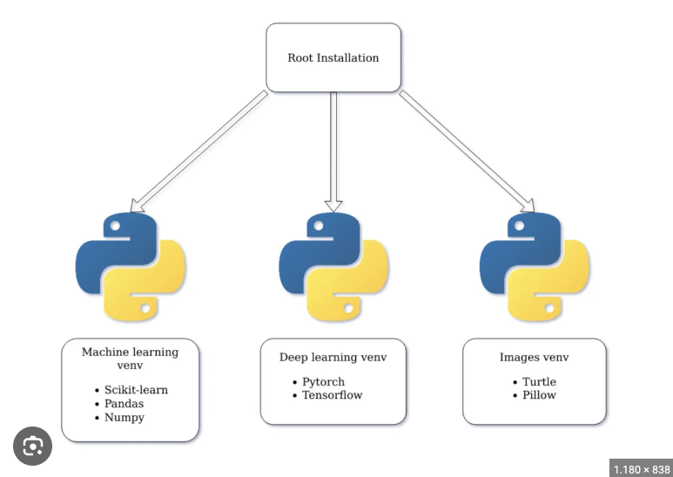
Python virtual environments
Is there anyone who already uses virtual environments?
Why is this useful?

Slide 34



Integrated Development Environment (IDE)
An Integrated Development Environment (IDE) is a very powerful editor that has a lot of useful extra features.
If you do not want to you do not have to leave the environment while programming.
What do you use? And why?

Slide 35
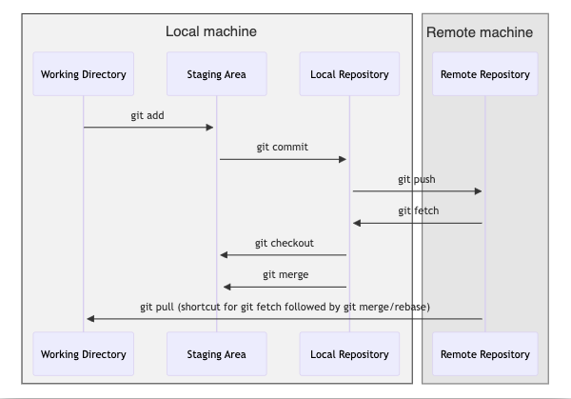
Software development lifecycle with git

Slide 36
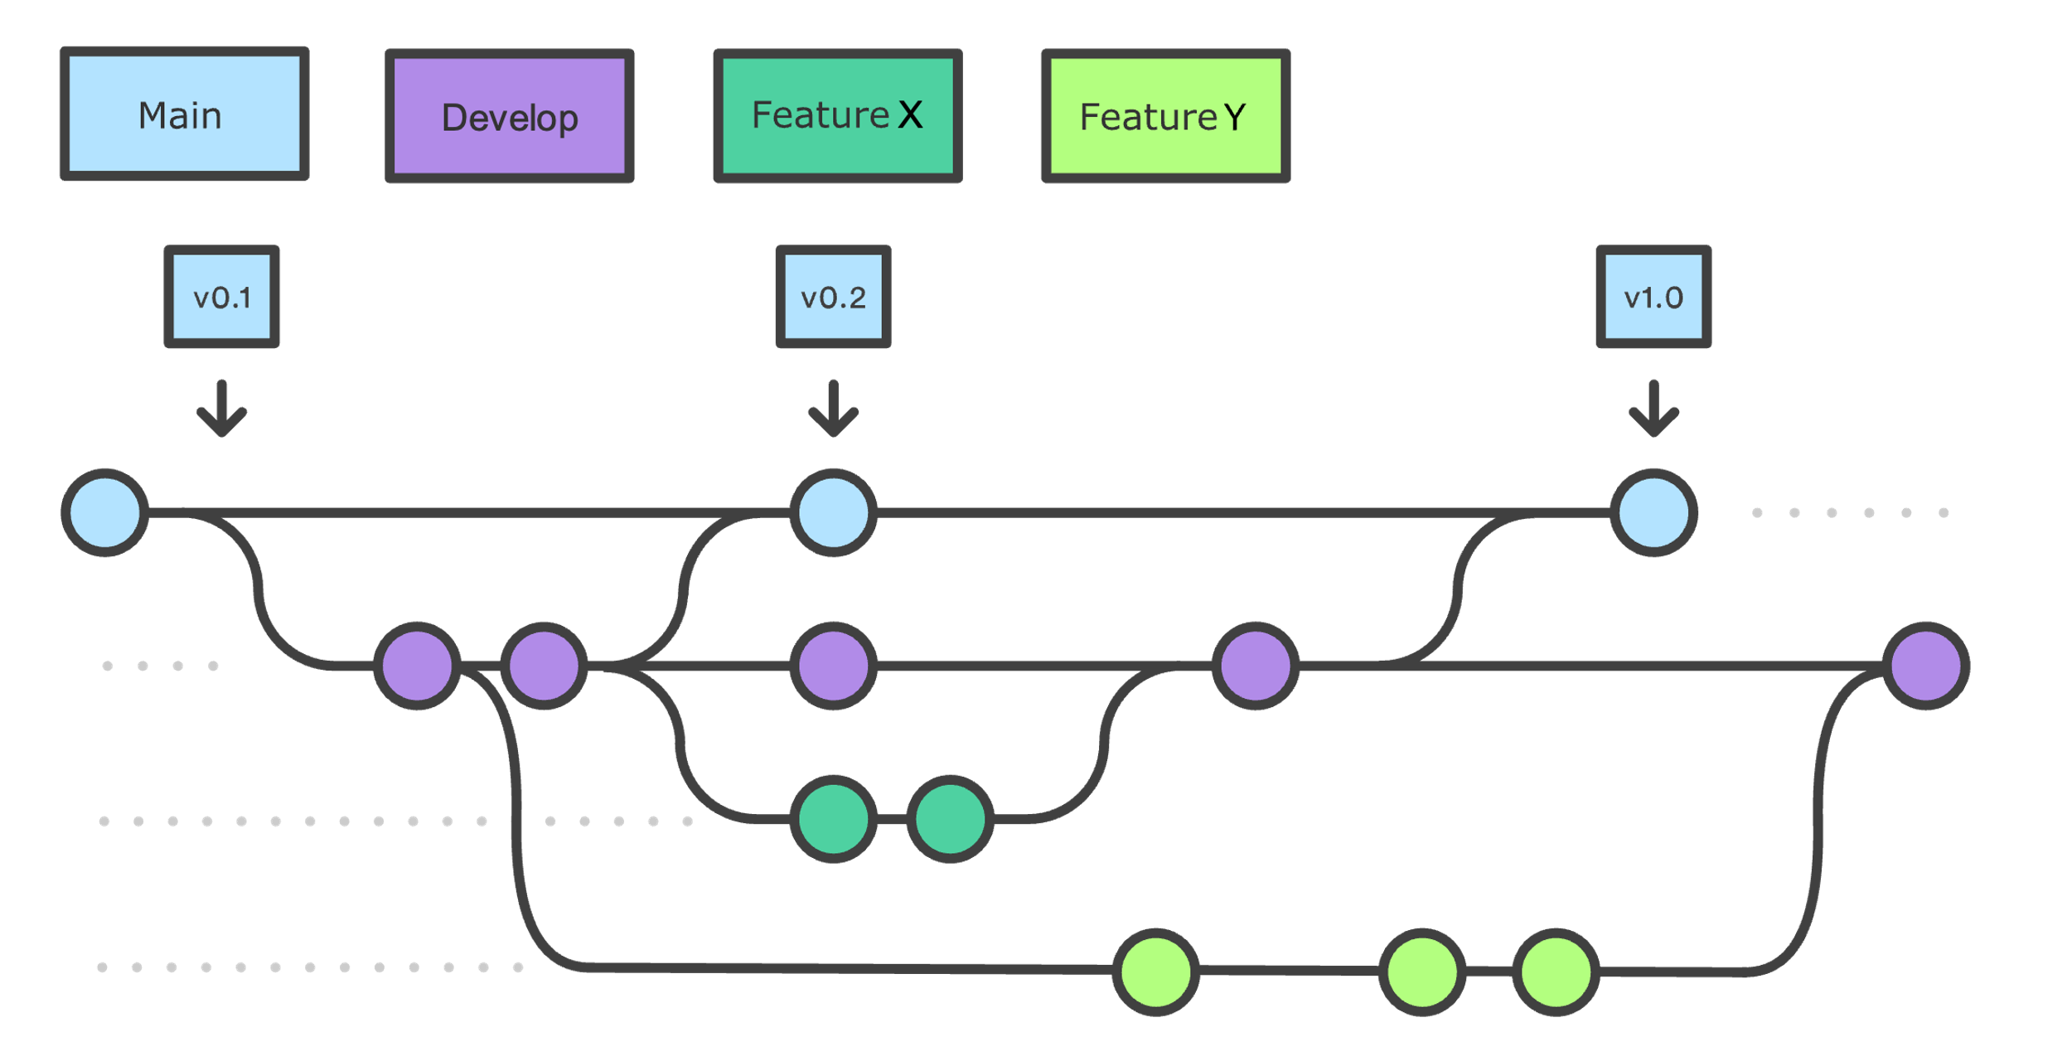
Git feature branches

Slide 37
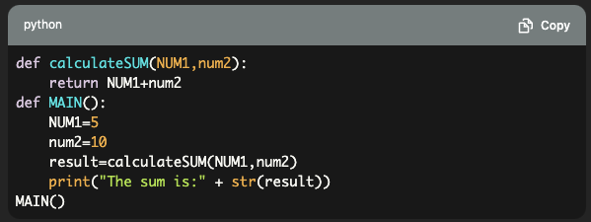
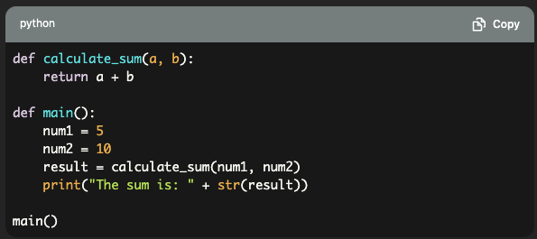
Python code style conventions
Which code is more readable?

Slide 38
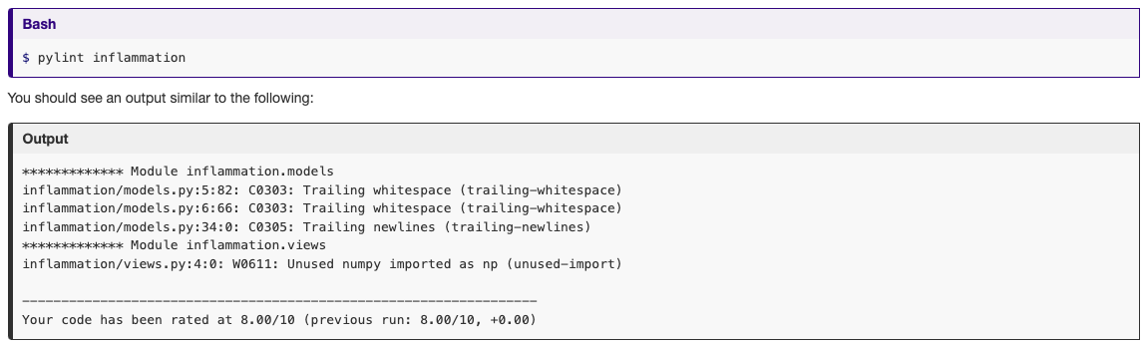
Verifying Code Style Using Linters

Slide 39
Tools Check
Git Bash/command line
Python, pip, venv
Git
GitHub accounts

Slide 40
Section 2: Ensuring Correctness of Software at Scale
Introduction to software testing and unit testing
An example dataset and application to test for correctness
Writing and running tests using the Pytest unit testing framework
Using parameterisation to reuse unit tests with different test data
Introduction to Continuous Integration (CI)
Using GitLab CI/CD to automate running of unit tests
Build matrices for cross-platform testing using CI
Debugging issues and improving robustness
Using PyCharm's debugger to diagnose and robustly fix a problem
As researchers we need to be able to verify and demonstrate that our code produces correct results, and unit testing - when done in the right way - can help, as well as save us development time in the long run
Notes:
In the first section, we looked at setting up a development environment
In particular, how we can use some commonly used tools to do this
With the command line we set up a virtual environment for our project
And used feature branch workflow to organise how we develop our codebase
We also looked at PyCharm, and how its features can help us
In this section we will look at what tools can help us verify that our software is - in some way - correct
And works the way we expect it to
We’ll be looking at unit testing as an established way to do this automatically,
Writing tests using the pytest unit test framework, and running them to check our code's behaviour
We'll also be looking at ways we can scale up and further automate our unit testing,
Using parameterisation to reuse unit test code with different sets of test data
And GitHub's continuous integration features to automatically run our tests on our code repo for us
Finally we’ll be looking at how we can use PyCharm's code debugger to check the behaviour of our code as it runs
To help us identify a bug and fix it
Overall, the key message is that as responsible researchers it's a good idea to be able to demonstrably show that our code produces correct results
At the Institute we've worked with many researchers, some of whom could not categorically say how or sometimes even why - their software's results were correct (were they even correct??)
Unit testing is one approach that can help us here
And that unit testing - in the long run - can save us development time if used correctly
Any questions before we begin?

Slide 41
Recap

Slide 42
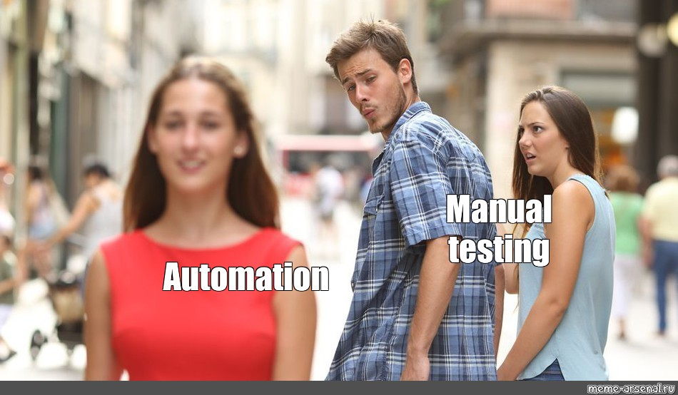
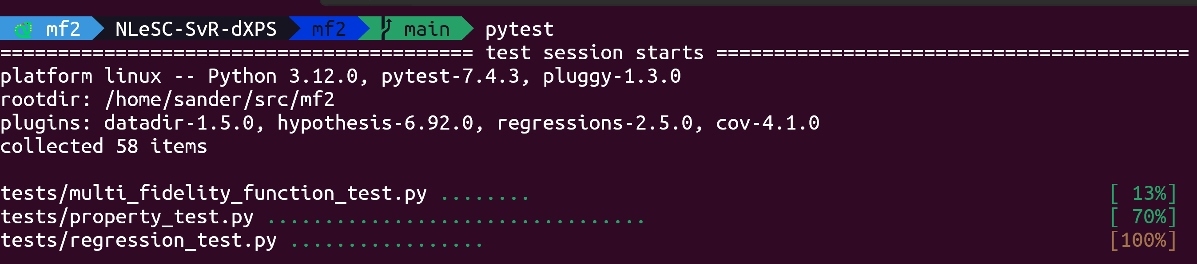
Automatically Testing Software
Notes:
Everyone is used to testing their software in one way or another. The simplest way is manual interactive testing, where you call your function manually in, for example, a Jupyter notebook and check the output is what you expect.
This works fine for the first few functions you write, but it doesn't really scale when your project gets larger. Especially when you get functions depending on other functions, it's too hard to manually keep track of which functions we *have* to test anyway.
Besides, constantly doing the same thing in order to perform manual tests sounds an awful lot like something we can automate right? That's exactly what automated testing is: writing functions to perform the testing you would otherwise do manually. The obvious benefit being that once you have these tests, the computer can automatically run them all for you.

Slide 43
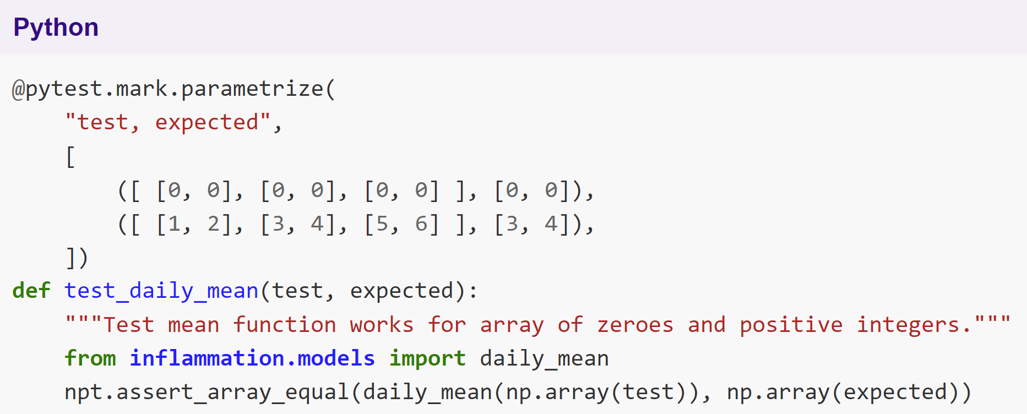
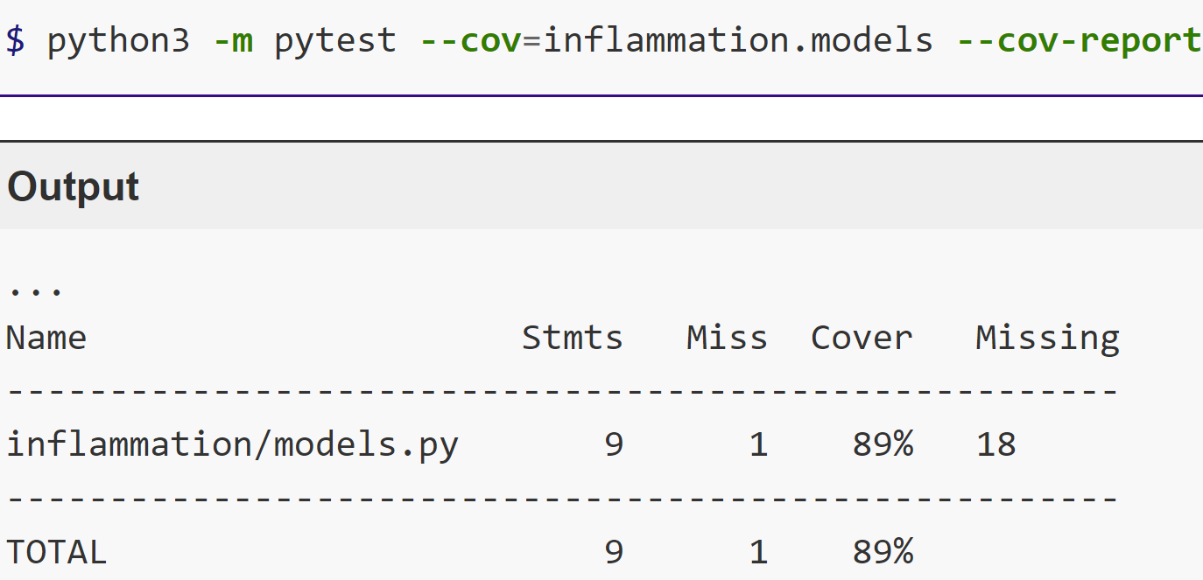
Scaling Up Unit Testing
Notes:
Once you've started with tests, or unit tests specifically, you'll probably notice a similar thing happening as in your regular code: repetitions.
Testing a certain function for different cases can of course be done by repeating the same test code with different values. In your 'normal' code, you would solve this with for-loops. This will still work in tests too, but then each case would not be shown as a separate test.
Pytest has a solution for this: parametrization. You'll learn how you can still specify your test to work on a single case at a time, and then specify the different cases above it. Pytest then takes care of running each of them.
The goal of having different cases is to make sure that all possible ways your code can run are checked. In testing terms, this is usually refered to as coverage. By running your tests with coverage, it'll let you know which lines are or aren't covered. This is a great way to check if you're forgetting to test any cases your code can handle, or to help decide what tests to write next.
Don't get distracted by the percentage coverage number though. It's very easy to write tests to get 100% test coverage, without actually testing anything of your code. As with anything: a metric can quickly stop being helpful when you use it as a goal.

Slide 44
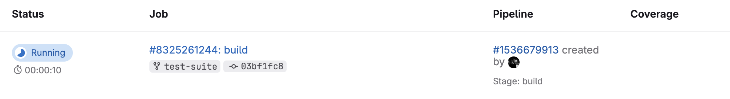
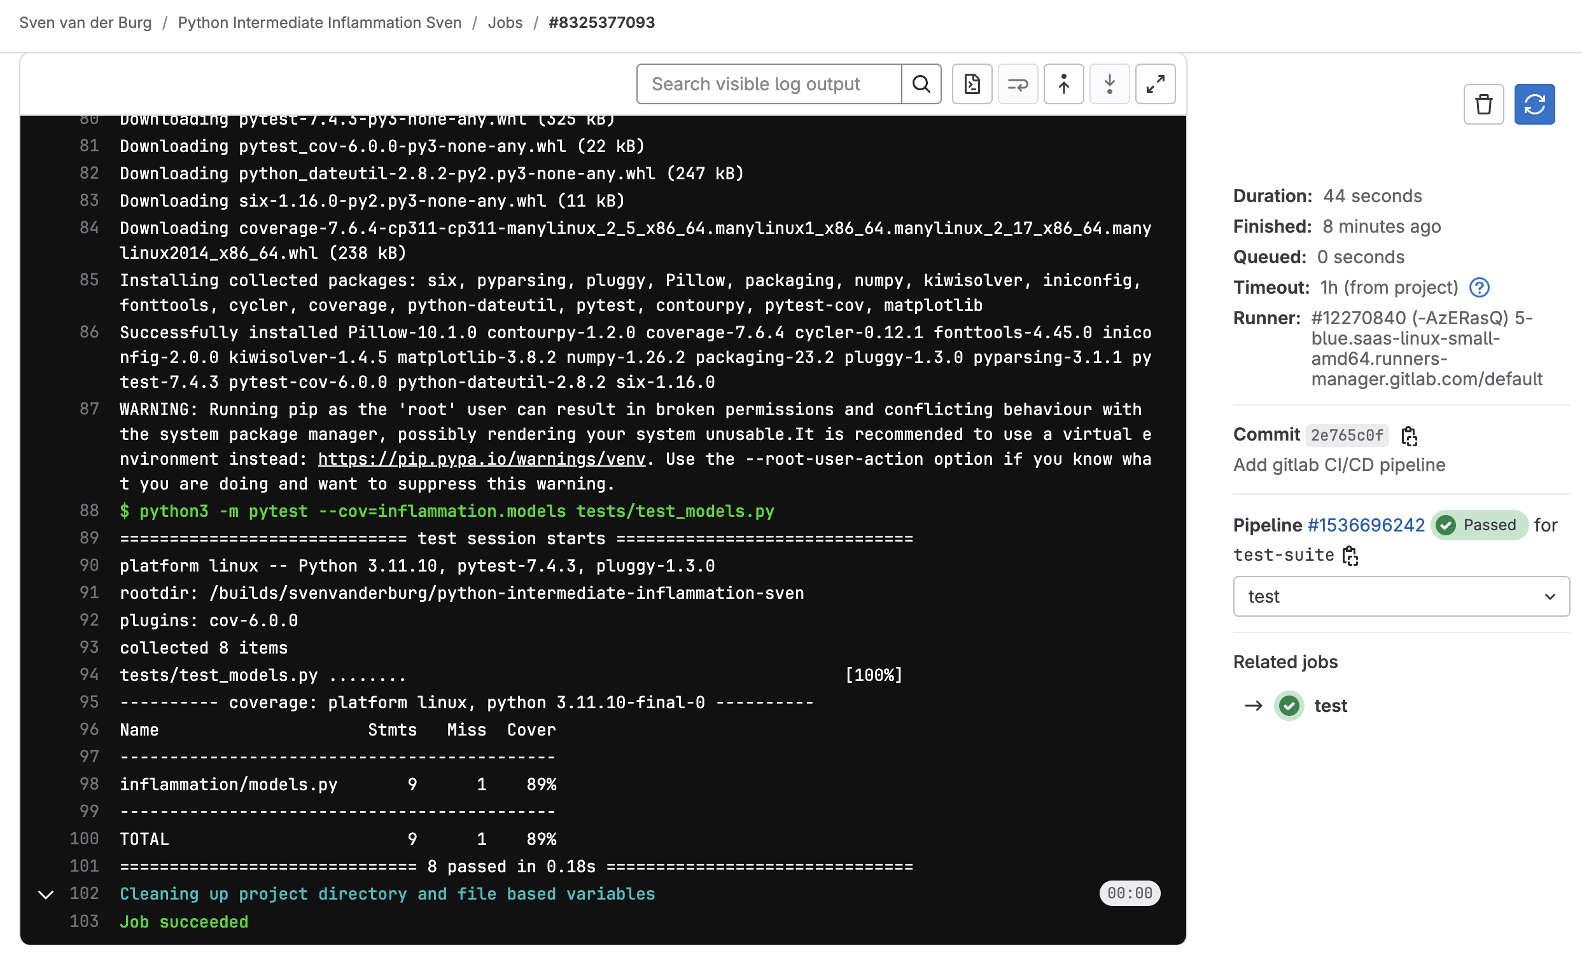
Continuous Integration for Automated Testing
Notes:
When you've written your tests, it would of course be best to have your tests run automatically too. When working with Gitlab as your remote repository, you can configure Gitlab to automatically run all tests when new commits are pushed to a branch, or on other triggers. This means you'll automatically get feedback on your code, even if you forgot to run the tests on your own machine before pushing the changes. This functionality is called ‘Gitlab CI/CD', and Gitlab very kindly allows every project some free minutes of runtime at this.

Slide 45
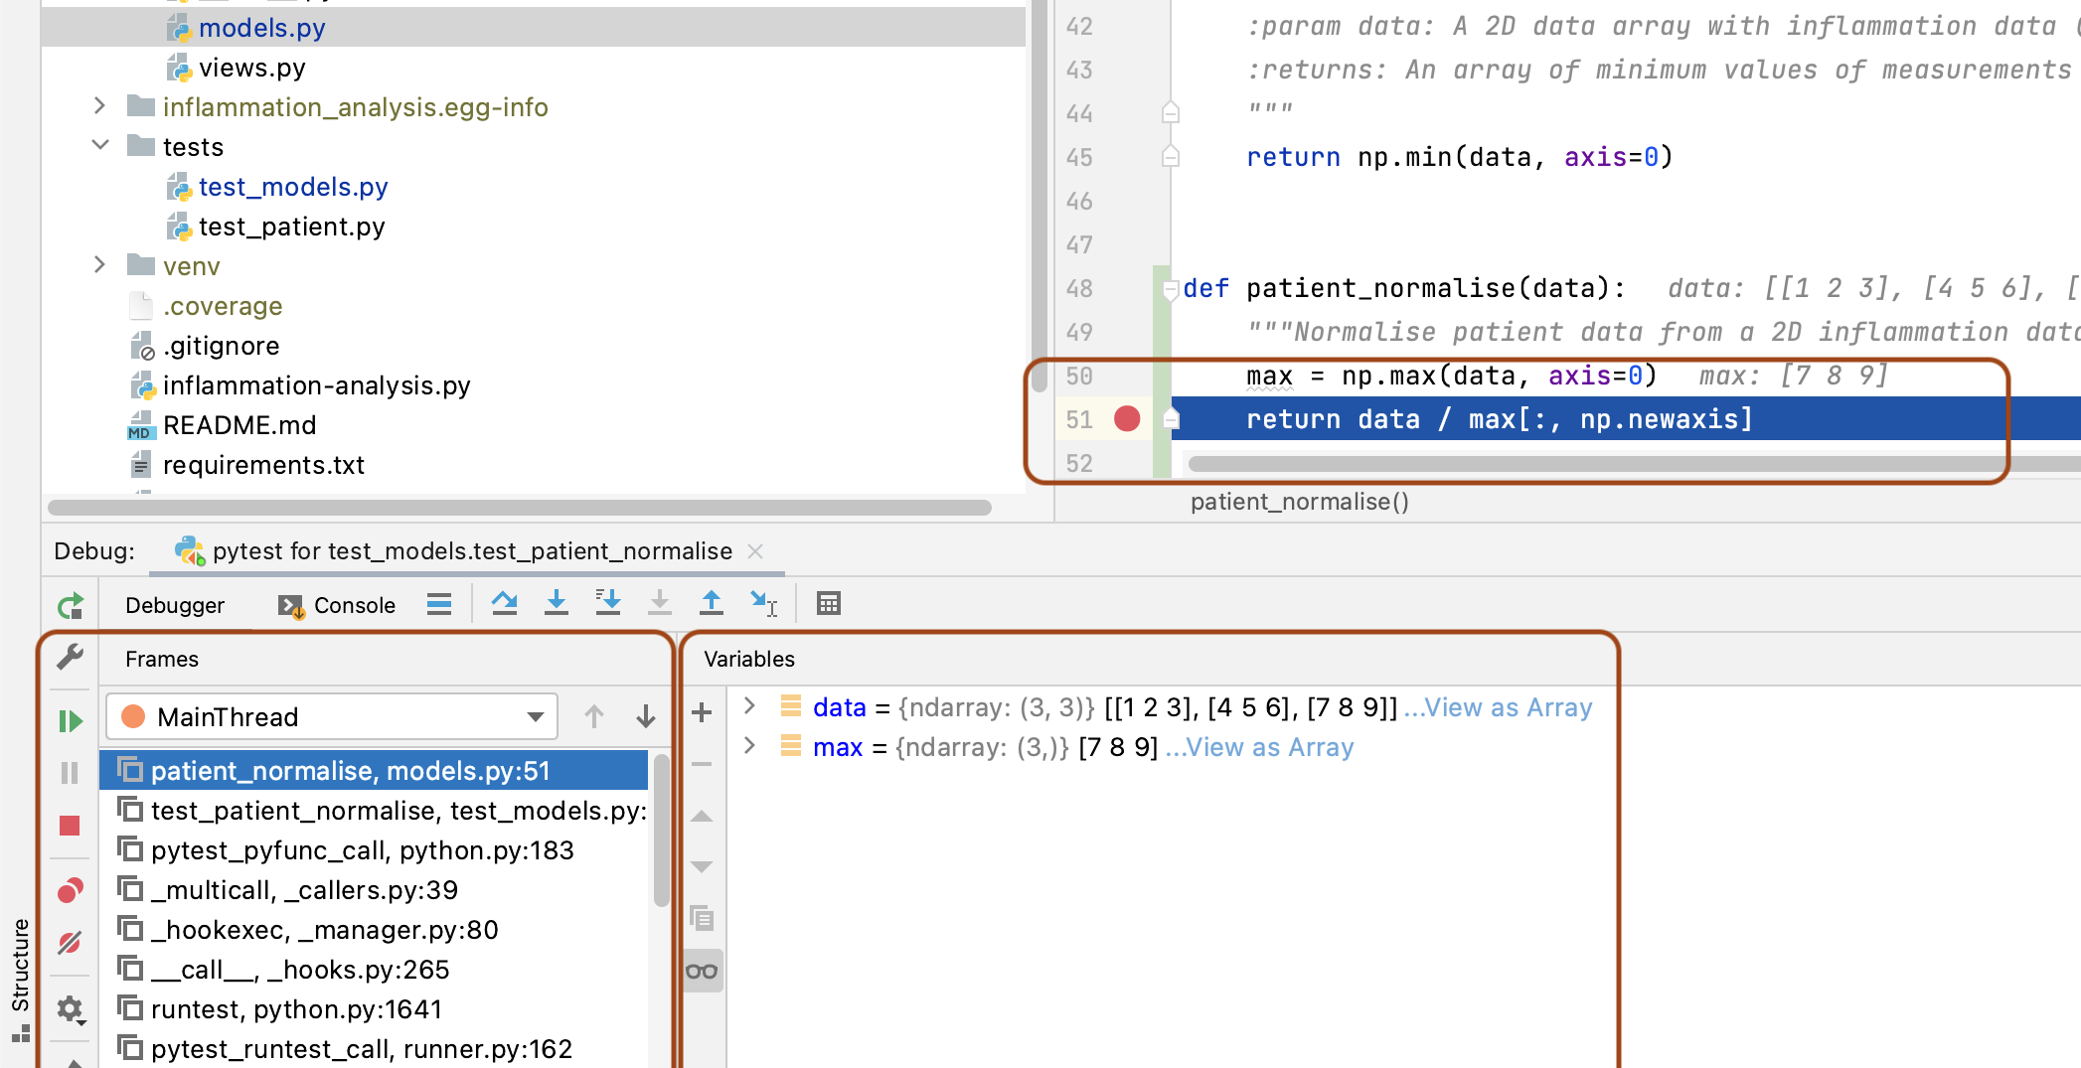
Diagnosing Issues and Improving Robustness
Notes:
Finally in this episode, you'll have a look at PyCharm's debug mode. It's a different way of running your code in PyCharm that's a bit slower, but will let you interrupt your program using preset break points so you can step through your code one instruction at a time. When stepping through code, PyCharm will let you look at the current values of all variables that exist in your program, and tells you exactly which functions were called to get to where you currently are.
This not only works when you've manually set break points, but also when your code runs into an exception on its own. Both ways are great tools to track down bugs and to determine how to fix them.
Remember that when you've found (and fixed) a bug, that those situations make excellent test cases, usually referred to as 'Regression tests'. By writing tests of the situations that could be used to recreate bugs you've encountered and fixed, you'll guarantee that the same bug shouldn't pop up again. Or at least not undetected!

Slide 46
Section 3: Software Development as a Process
Programming vs software engineering
Software requirements, design, architecture and implementation as typical stages of a software development process
Design requirements and constraints - what affects our design choices?
Software design
Writing readable, maintainable and testable code
Pure functions, classes and abstractions
Software designed deliberately will be much easier to work with in the long term than software we build without a plan - time spent planning in advance will save you a lot more time later
Notes:
The terms programming (or even coding) and software engineering are often used interchangeably. They are not. Someone who is engineering software takes a wider view:
The lifecycle of software: from understanding what is needed, to writing the software and using/releasing it, to what happens afterwards.
Who will (or may) be involved: software is written for stakeholders. This may only be the researcher initially, but there is an understanding that others may become involved later (even if that isn’t evident yet). A good rule of thumb is to always assume that code will be read and used by others later on, which includes yourself!
Software (or code) is an asset: software inherently contains value - for example, in terms of what it can do, the lessons learned throughout its development, and as an implementation of a research approach (i.e. a particular research algorithm, process, or technical approach).
As an asset, it could be reused: again, it may not be evident initially that the software will have use beyond its initial purpose or project, but there is an assumption that the software - or even just a part of it - could be reused in the future.

Slide 47
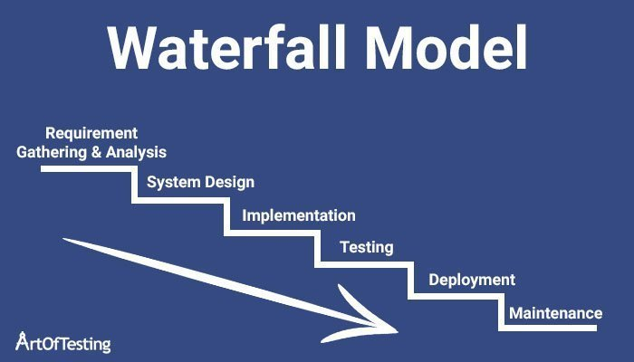
Software development as a process
Notes:
The software development process consists of multiple stages, which in the 'traditional (/ old fashioned)' waterfall model follows one step after another.
So far, you are all familiar with the "Implementation" step, as that 'simply' consists of the programming you're already doing, and you have worked a bit on the "testing" step too, to make sure what you've implemented is actually correct.
But it's also important to consider what you actually want to implement in the first place
*click to reveal 'System Design'*
After all, it doesn't make sense to start programming if you haven't thought about what you're going to build in the first place.
But there's more you can take into account when designing your program than just how to implement and test it.
*click to reveal 'Deployment' and 'Maintenance'*
How you deploy and eventually have/want to maintain your project can also influence your design decisions.
Although Deployment and Maintenance are typically much less 'formal' in a research (and especially in an academic) setting compared to a corporate setting.
Think of the different in running your analysis for a paper compared to deploying a new version of the ns.nl website.
There is actually one more step in the process.
Just like you can't build without a design, you can't really design without knowing what you want.
*click to reveal 'Requirement Gather & Analysis'*
That's where properly specifying your requirements comes in.
Taking dedicated time to think about what the requirements of your project are can be vital in making the right (design) decisions at the start.
After all, the sooner you can correct or avoid a mistake, the cheaper it is.
Requirements are rarely static though.
More often than not, you will realize that answering a question only raises more, or that what you thought of before is not actually what you end up needing.
This is to be expected and should be accepted and prepared for.
But that does mean that the simple waterfall from requirements to maintenance is not going to be sufficient.

Slide 48
Software requirements
Without clear requirements you will find out later that you built software that no one actually needed.
Requirements will constantly change!

Slide 49
Software requirements
Without clear requirements you will find out later that you built software that no one actually needed.
Requirements will almost always change!
Warning: Explicitly describing requirements can feel like a lot of overhead.
Notes:
Agile: sprints, every 1- 4 weeks a waterfall cycle

Slide 50
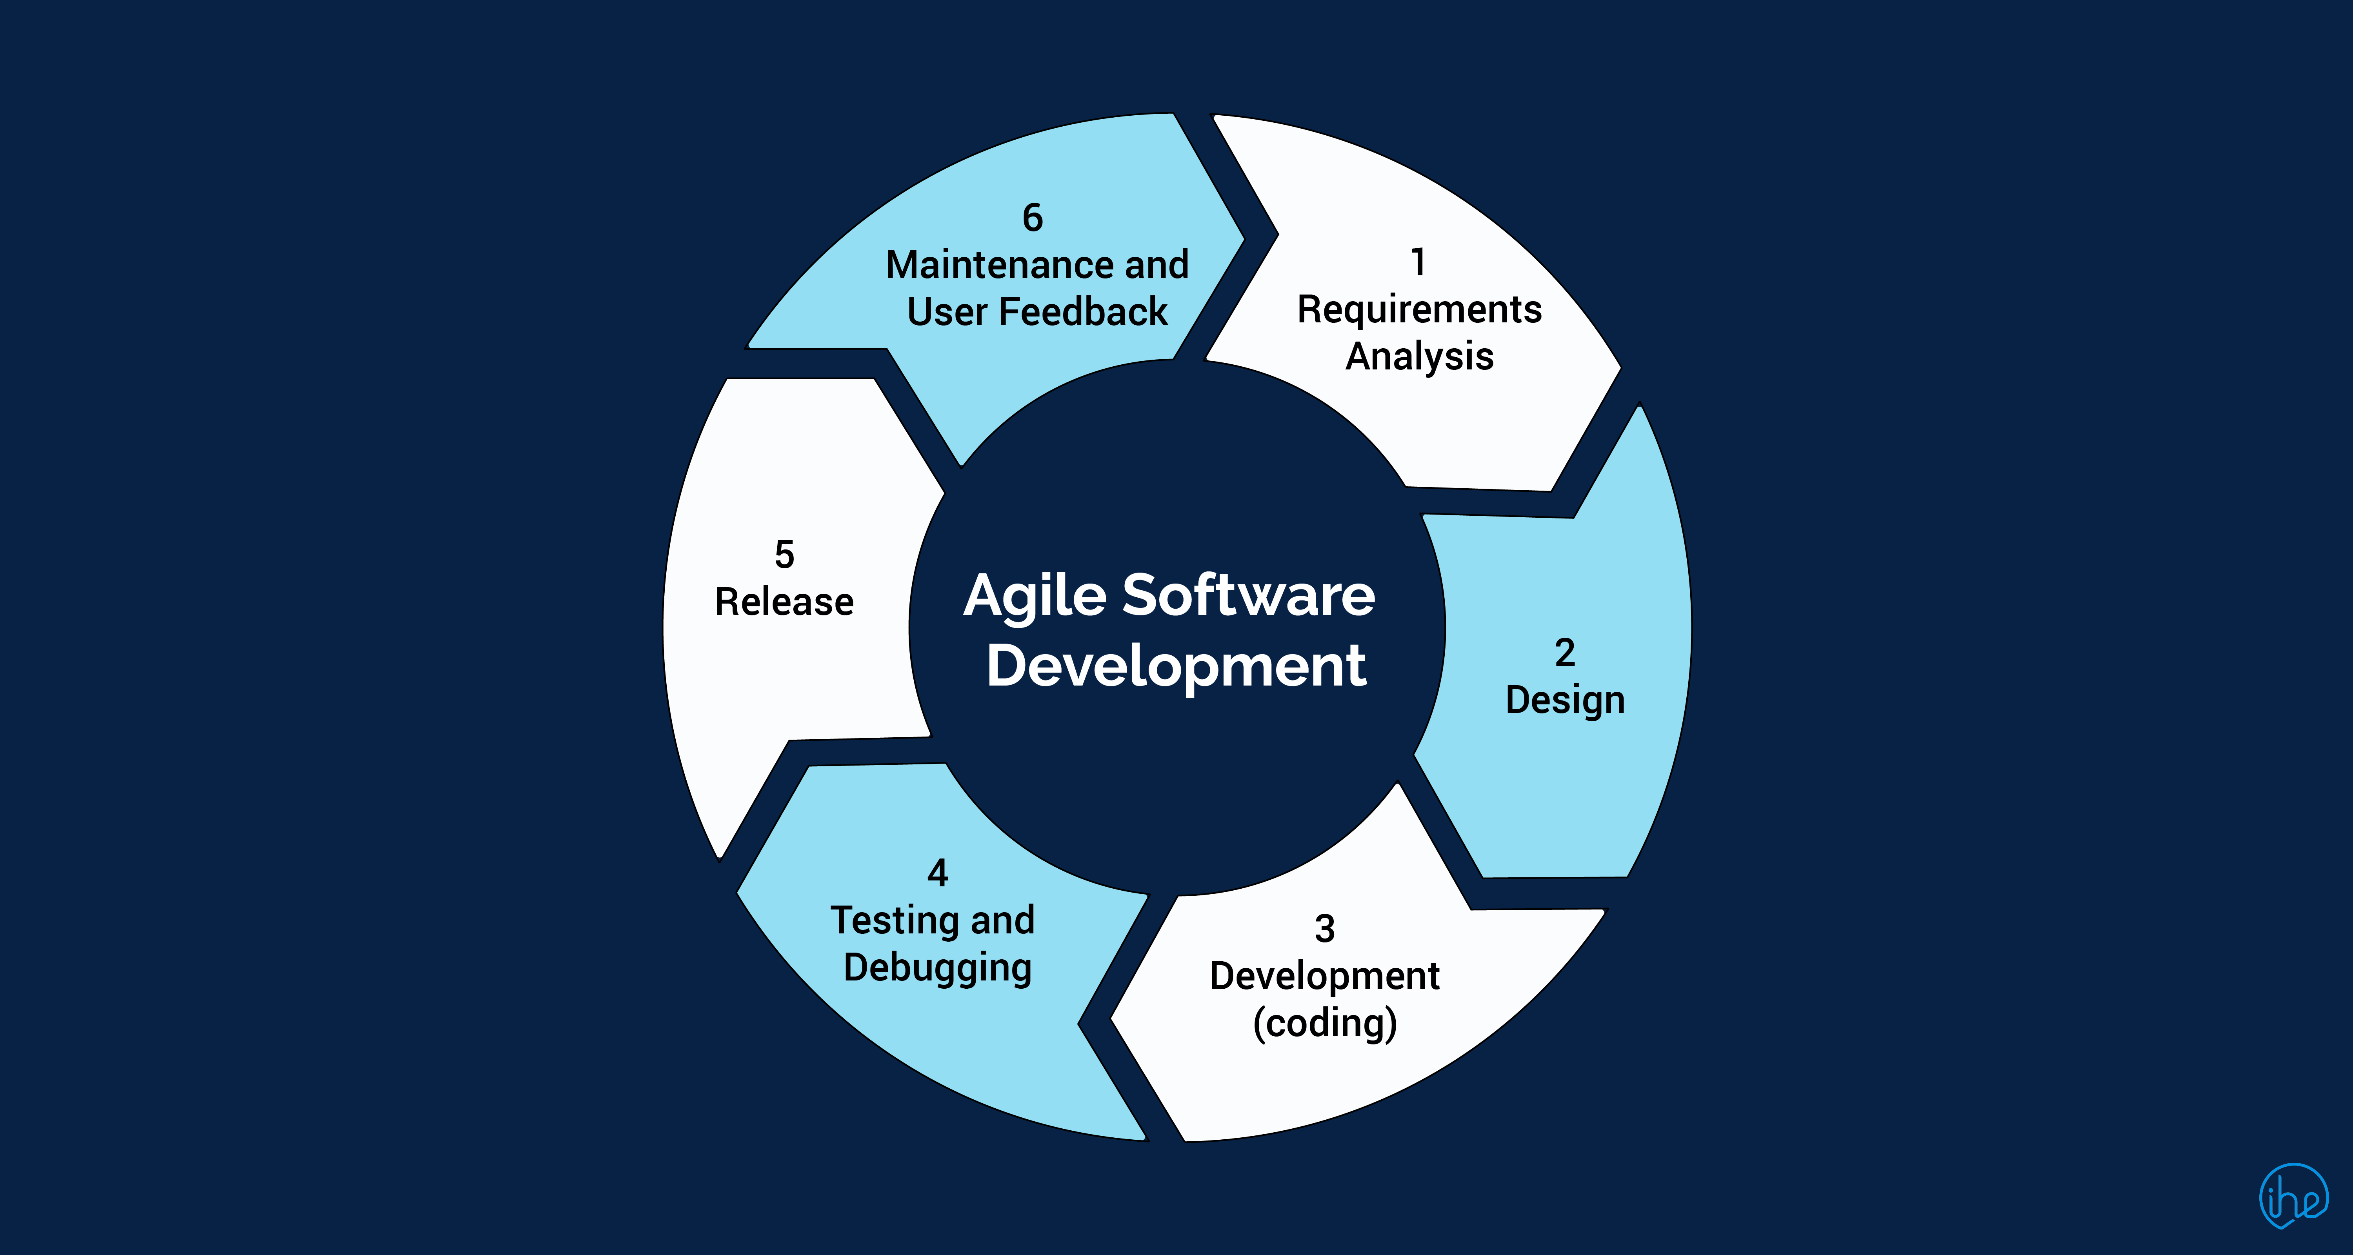
Software development as a continuous process
Image from: https://blog.stackademic.com/understanding-lean-startup-and-agile-development-c42677a95d03
Notes:
So instead of this waterfall model where you only go through each stage once, you're looking at a continuous or iterative process, where you keep updating or re-evaluating your requirements at some level every once in a while.
Whether that is strictly every two-to-four weeks as in Agile, or more fluidly is completely up to you.
Sometimes it might just be a quick check to confirm that your current requirements and corresponding design are still valid, that's fine too, as long as you've given it some explicit thought.

Slide 51

Software design
Under-design
Technical debt
Over-design
Overhead
It is your job as engineer to find a balance in the tools that you will learn.

Slide 52
6 techniques for good software design
Episode 3.3
Code abstraction
Code decoupling
Encapsulation
Polymorphism
Episode 3.4
Code refactoring
Pure functions

Slide 53
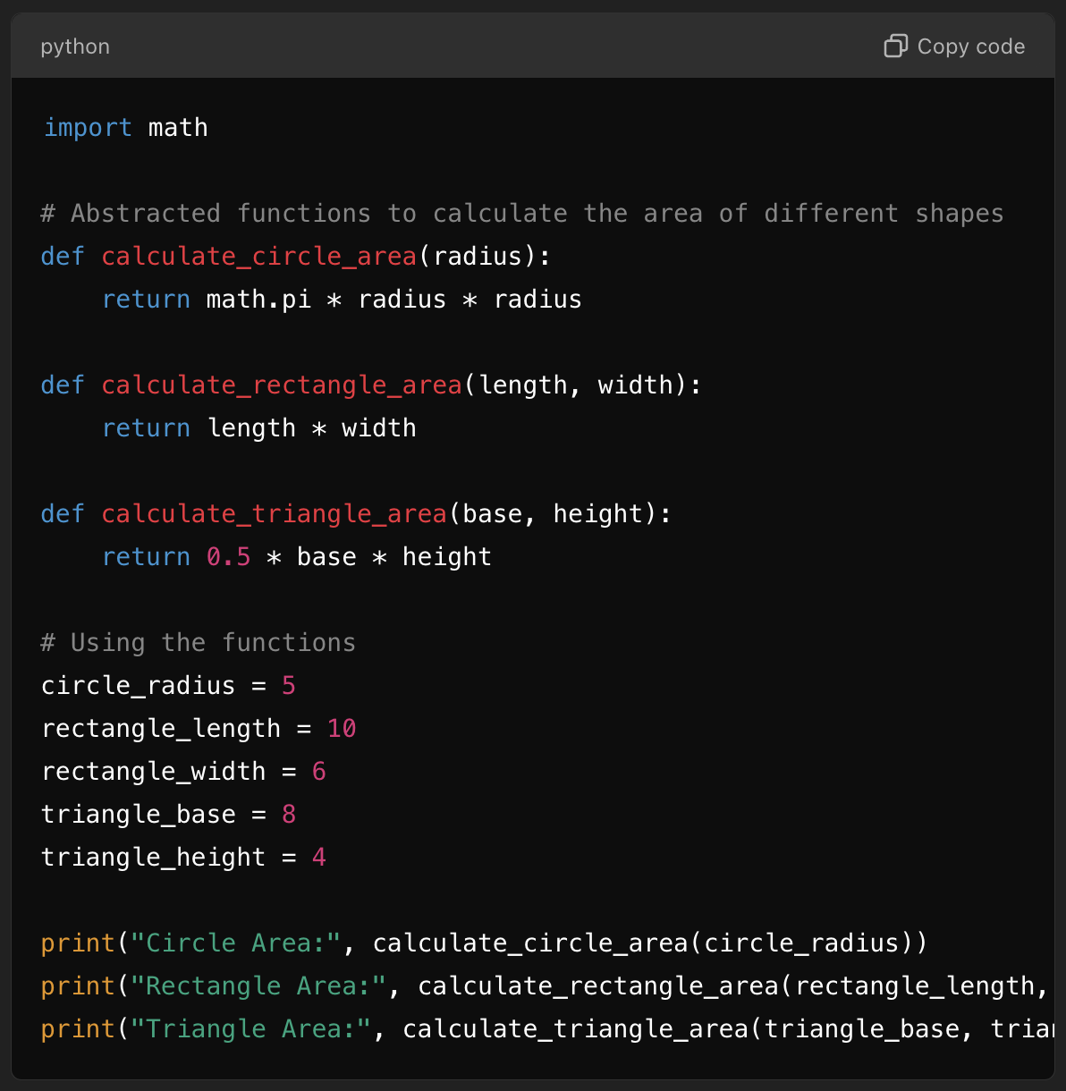
Code abstraction
Details of ‘how’ something works are hidden. You only deal with ‘what’ the code does.
You (or a user of your code) only need to understand the higher level of abstraction and not the details.

Slide 54
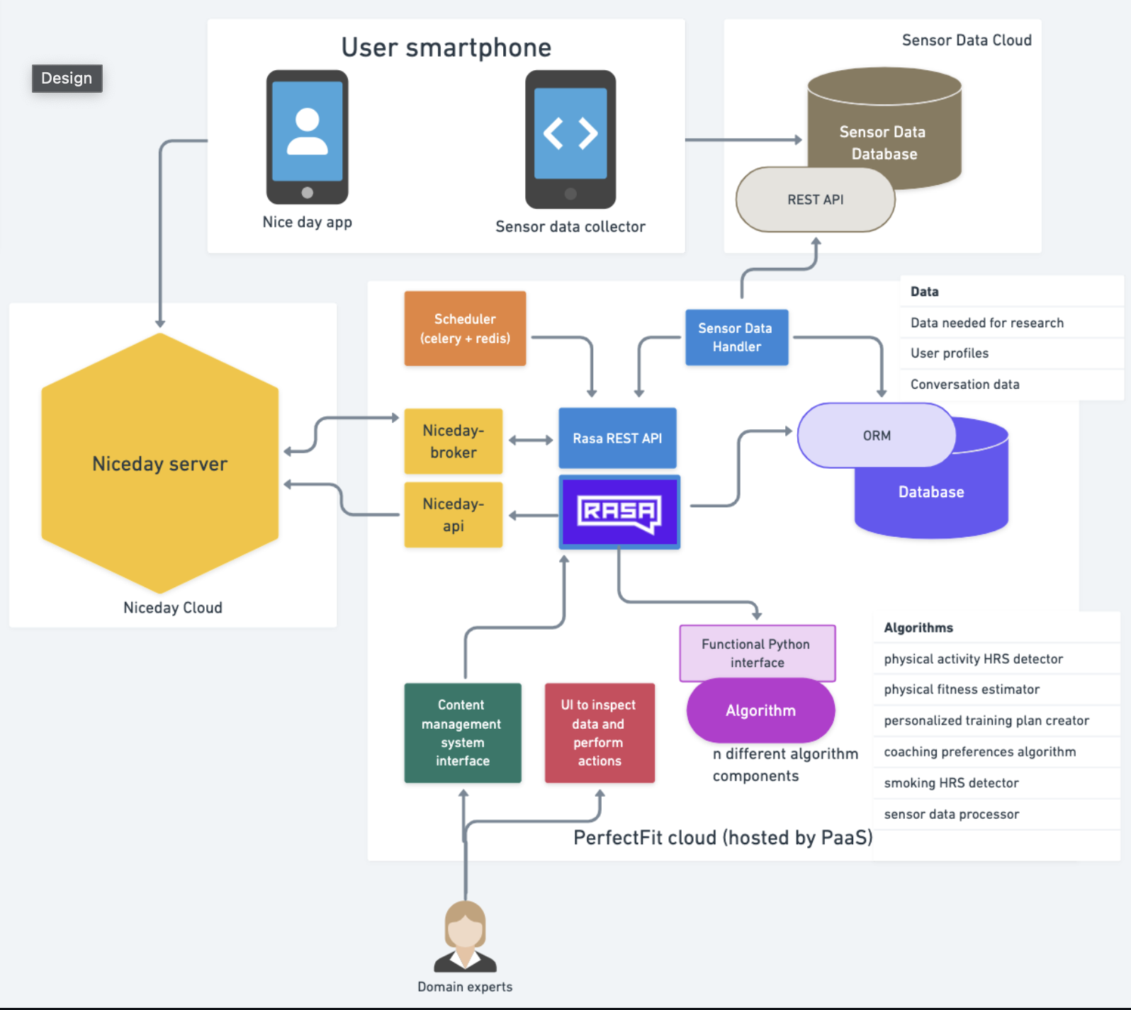
Code decoupling
Breaking up software in smaller components to reduce the interdependence.
A change in one component does not necessitate a change in the other.
Clear interface between components

Slide 55
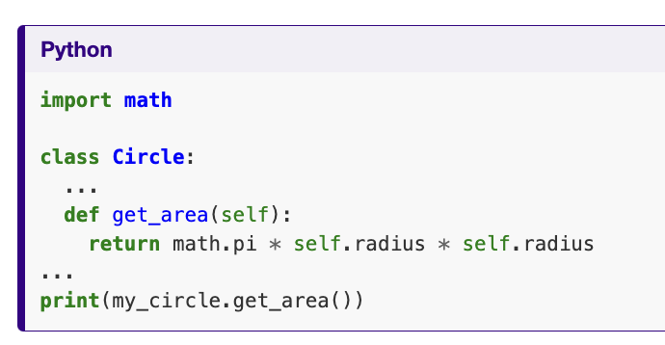
Encapsulation
Packing data and functions operating on it in a single component.
In Python you can group together data and methods in a class. An instance of a class is called an object.

Slide 56
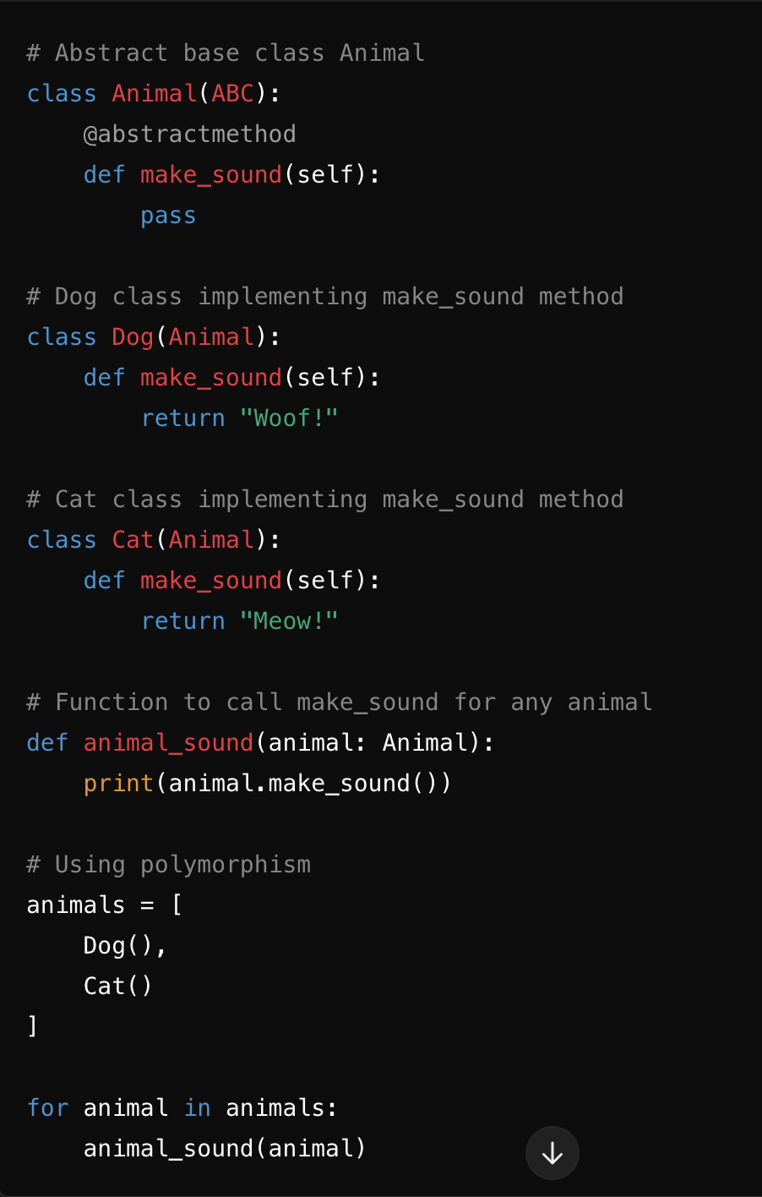
Polymorphism
Having multiple implementations/shapes of the same abstract concept

Slide 57
Code refactoring
Improving the structure of the code, without altering its function.
How can we ensure that the code still works after refactoring?

Slide 58
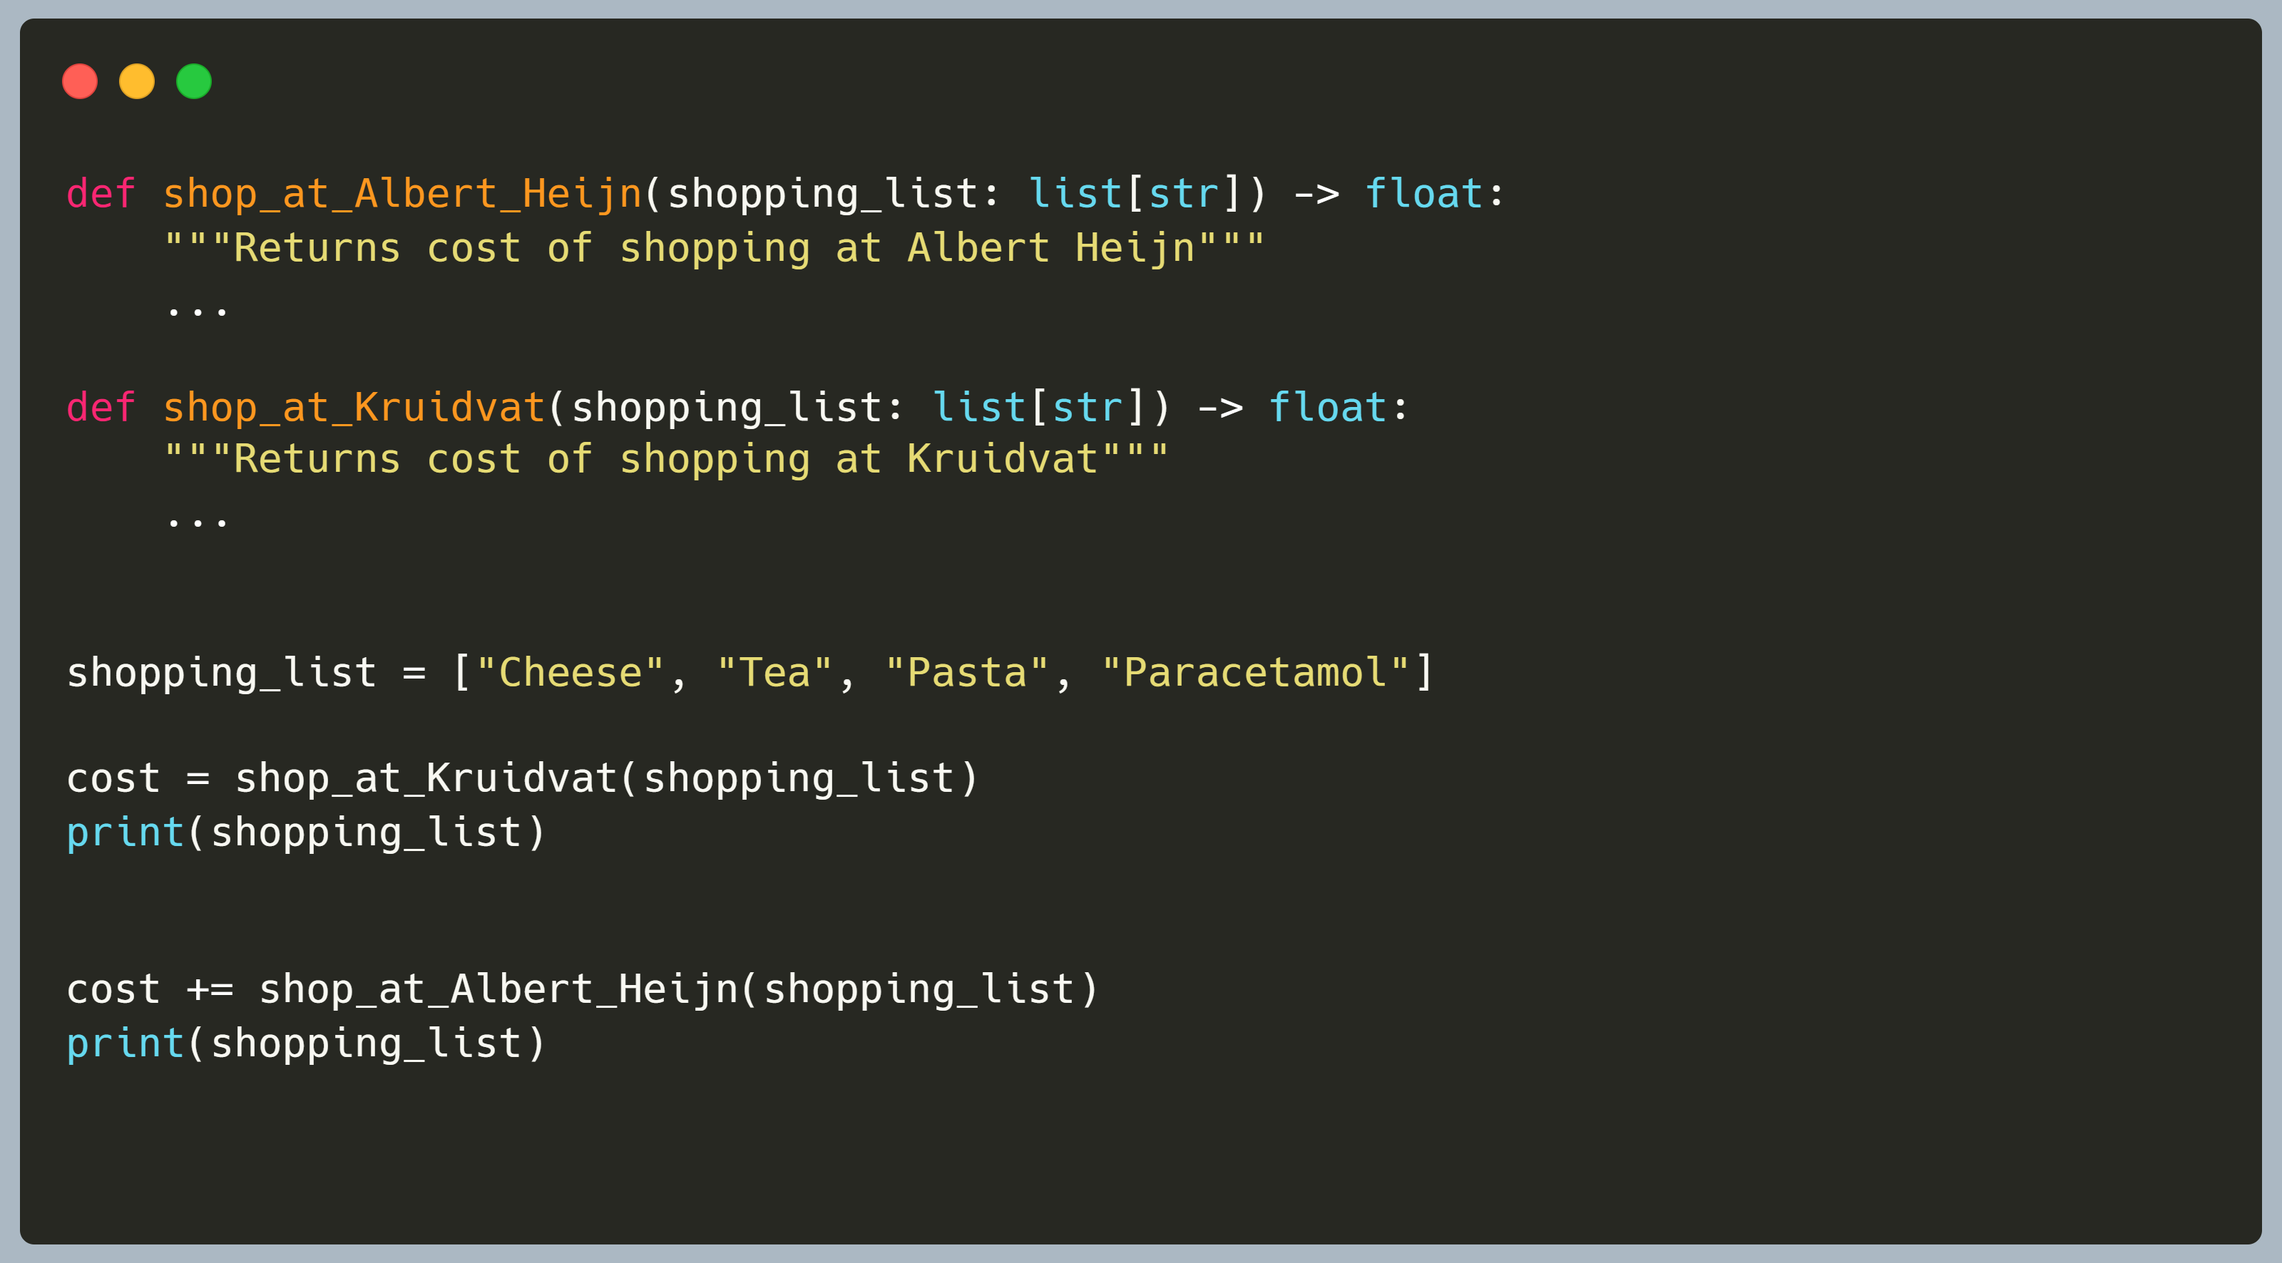
Pure functions have no side effects
Easy to read, write, test, and maintain
Notes:
Here is an example of an impure function in use: We have two functions `shop_at_Albert_Heijn` and `shop_at_Kruidvat` that calculate the price of buying products from a shopping list at their stores.
Kruidvat sells tea and paracetamol, but does not sell cheese or pasta, so we will have to buy those products at Albert Heijn using the second function.
These functions work just like how you would use a shopping list in person: once you've bought a product, that product is crossed out or removed from your list.
*click to next slide*

Slide 59
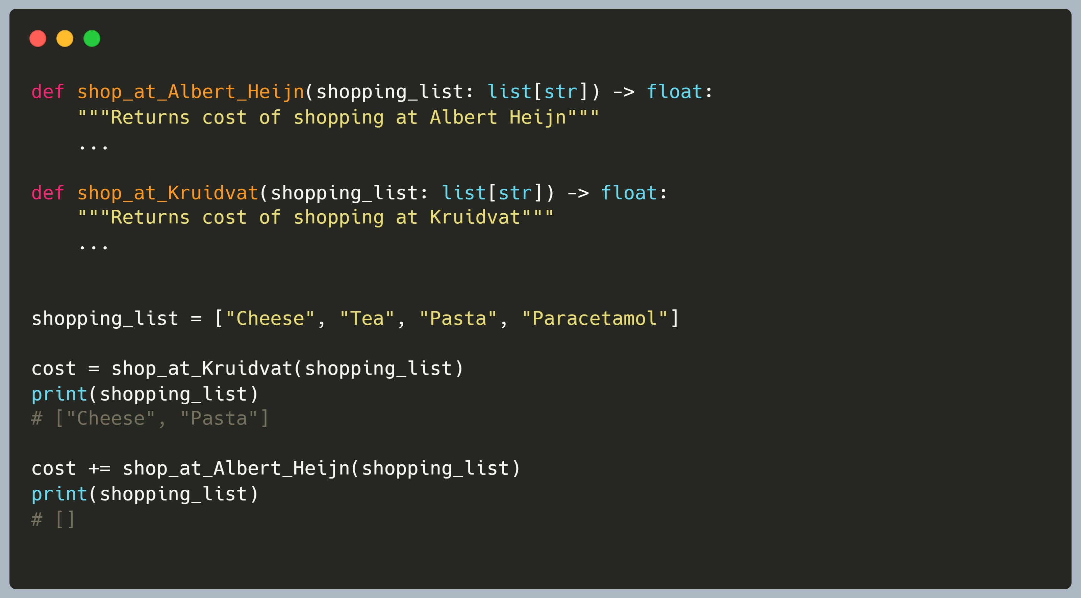
Pure functions have no side effects
Easy to read, write, test, and maintain
Notes:
As you can see, the tea and paracetamol have now been removed from the shopping list.
This means that when using the same `shopping_list` variable, we only end up buying cheese and pasta at Albert Heijn instead of the full list.
In this case that is the intended behavior of the programmer, but it does make the function harder to use generically, harder to document and harder to test.
For example, we can't easily re-use the same shopping list to check which order of shopping would be cheaper: our shopping list is empty after calling both for the first time, and in this case we don't have a copy of the original anymore.
In short, a pure function should always return the same output for the same input, and should not change anything outside itself.
This also means it should be independent of any other local/global variables that may be around.
By writing our functions this way, they usually become easier to work with, and especially to test: there will never be any (unexpected) dependencies on other tests or state.

Slide 60
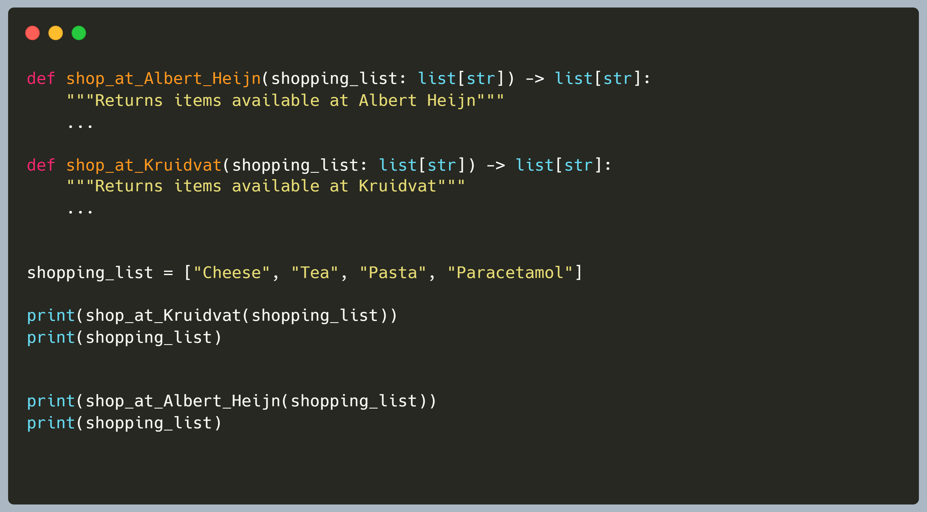
Pure functions have no side effects
Easy to read, write, test, and maintain
Notes:
How might we rewrite this to be pure functions?
One way could be to first create a function that returns a new list with only those items available at that store

Slide 61
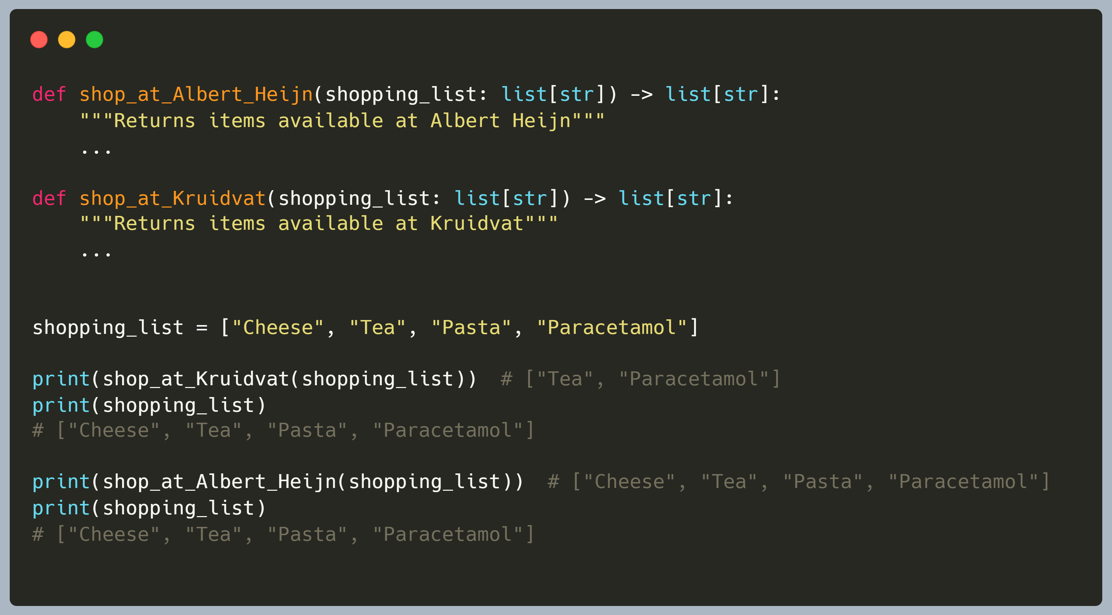
Pure functions have no side effects
Easy to read, write, test, and maintain
Notes:
With these new functions, our original shopping list is unchanged.
We could then write separate functions that calculate the price for certain items at a certain store.
Those can then be combined in another function that takes care of buying things from the shopping list in order so we don't buy anything twice.
Note that this is just an example/suggestion, and other/better ways of structuring functionality might be possible
However we end up **refactoring** the original implementation, while it might be a bit more work to separate out the functions like this, we do end up with functions that are smaller, do a single clear thing and are much easier to test.
The concept of only programming with such pure functions is a paradigm called functional programming, and is one of several programming paradigms that Python supports.
(Other paradigms can include procedural and object oriented programming)

Slide 62
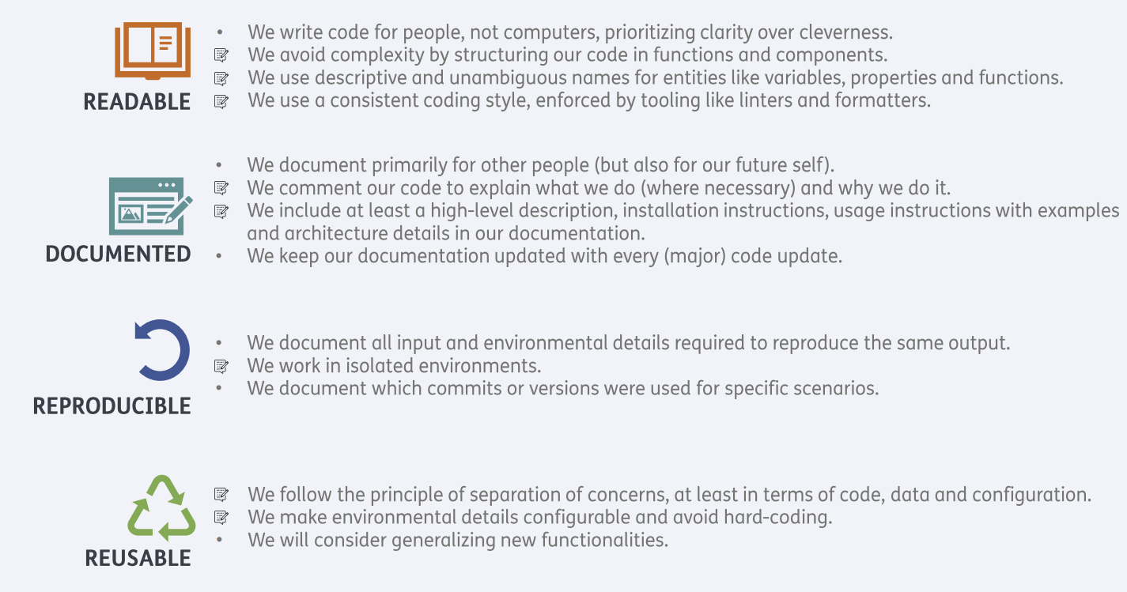

Software Development as a Process

Slide 63
Section 4: Collaborative Software Development for Reuse
Practices for developing software collaboratively that will make it easier for us and others to further develop and reuse
Code review
Improving the quality of code
Detecting bugs and code defects early
Increasing knowledge of the software within the team
Preparing software for reuse
Levels of reusability
Documenting code for reuse
Choosing an open source license
Packaging software for release and reuse
When changes, are made to a codebase, how can a team ensure that these changes are well considered and represent good solutions?

Slide 64
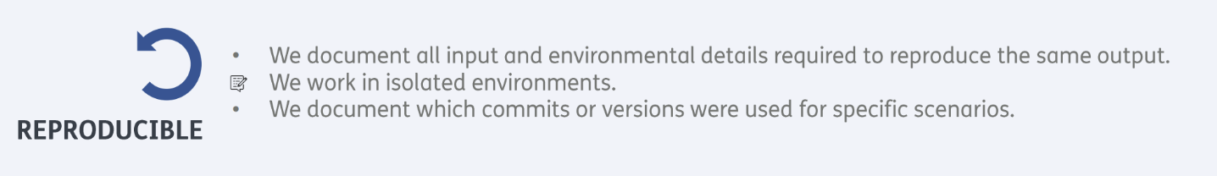
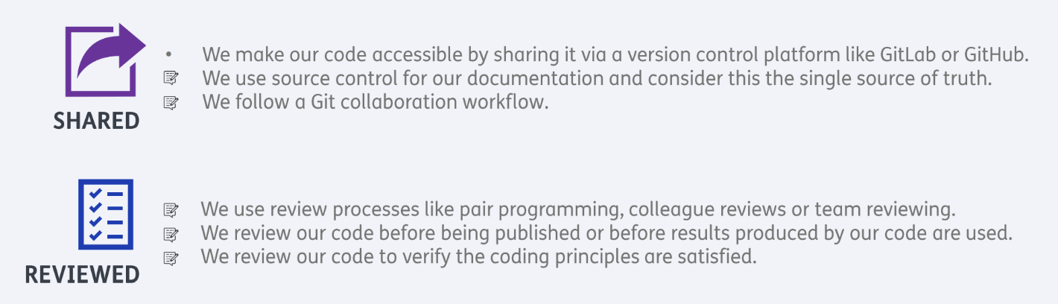
Git & GitLab

Slide 65
Collaborative Code Development Models
Shared Repository Model -> collaborators all work in a single repository
Fork and Pull Model -> external contributions from forked repositories
When to use which model?
Notes:
In this episode you'll learn how to work together using code review. This can be done in several ways, but we'll show you the most common way this is done in large organizations and in most open source projects: using the <click> fork and <click> pull method.
<next slide>

Slide 66
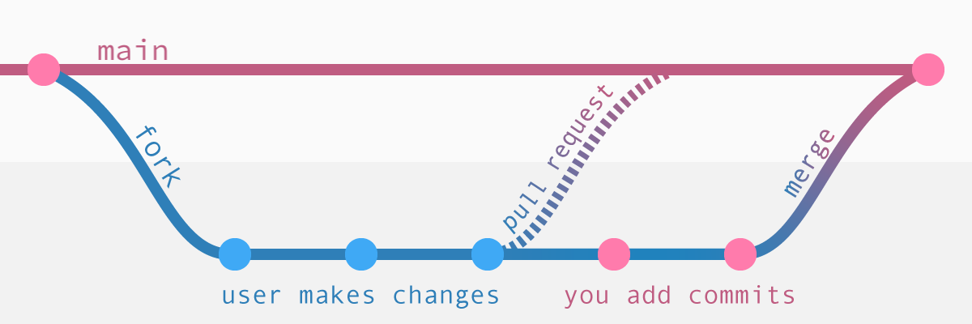
Developing Software in a Team: Code Review
Notes:
Here's a schematic overview of the Fork & Pull method: It should remind you of a git workflow with feature branches. In principle, that's exactly what this is.
To Fork a repository means to make a personal copy of a repository in your account. Note that this is a account action which maintains the link between the repository on your account and the original one.
You can use the fork to create your feature branches for whatever changes you want to make. But instead of directly merging, you have to make a request to the original repository to accept your merge. In GitHub terms this is called a Pull Request (PR), as you're asking them to pull your changes into their repository. On GitLab, this same process is called a Merge Request (MR).
The PR is again a GitHub specific thing, which creates a place to view the proposed changes and discuss them. Any future pushed commits to the branch for which you've made the PR, will automatically update the PR.

Slide 67
Let’s look at a real-world peer review
https://gitlab.com/LXCat-project/lxcat/-/merge_requests/14

Slide 68
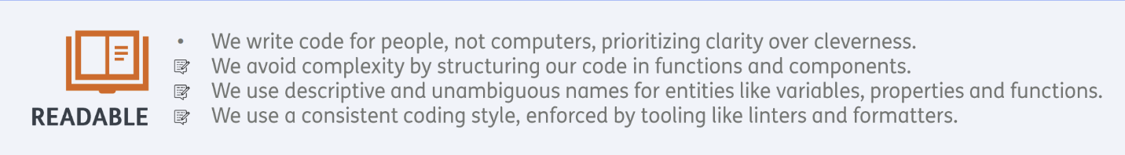
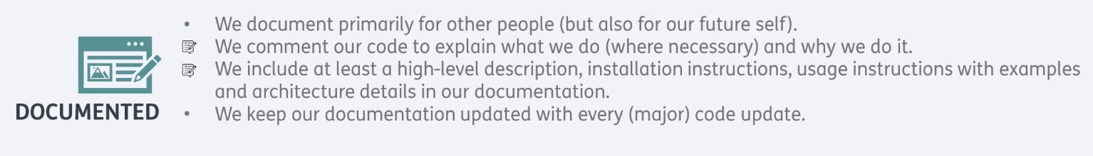
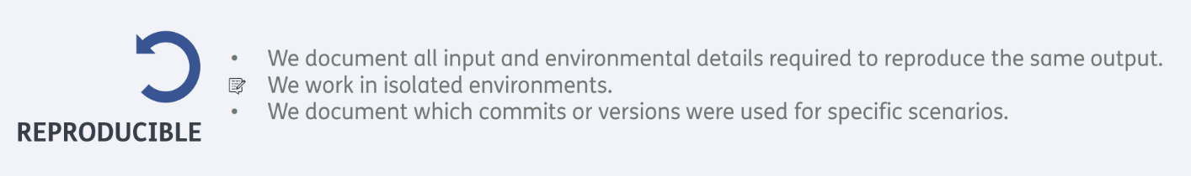
Documenation

Slide 69
Code documentation
Probably the most underappreciated but most important skill of good software engineering practices.
If I spend some time now on documenting my code well, this will save me time and headaches later.
Notes:
Another important part of online collaboration and preparing your code for reuse and release is to create a good README. This is the billboard for your repository and is shown as your 'homepage' on GitHub. There are several best practices of what should be included in a README, which you will learn about in this episode.
Documentation does not only help others, but also yourself: if you work on other projects and come back later, you will have forgotten most of the details.

Slide 70
Packaging Software for Release and Distribution
Packaging software that someone can install and use it more simply.
for example: install using pip
More advanced package management using Poetry
Notes:
Finally you will learn how the actual publishing of python packages works using Python's Poetry <click, shows Zen of Python poem>
Okay, not actually this kind of poetry, although I do like this one. (If you want to read it yourself later, try 'import this' in your python console)
<click> Instead, I mean the Python tool called Poetry. This is a tool meant to manage your package dependencies and to help build and publish your package to the Python Packaging Index: PyPI so it can be 'pip install'ed by others. Even if you don't actually want to upload your package publically, it's still useful to know how to make your packages installable, as it also means you can locally install your code to make it easily reusable in your various working environments.

Slide 71
Section 5: Managing and Improving Software
Software not only needs to be developed, but also managed
Collaborative platforms are a means of communication and documentation
Estimating the required effort for work items is useful to set priorities

Slide 72
Managing a Collaborative Software Project
Platforms like GitHub provide tools to manage software
Manage bug reports, feature requests and future work with issues
Use labels to categorize issues: "bug", "enhancement", "help wanted", ..
Example
Notifications & referencing make it easy to reference
Collaborators with mentions: @f-hafner
Issues, pull requests and comments: #14 Some issue
Manage software projects with project boards
Overview of open issues, current work, planned work, etc. Example

Slide 73
Assessing Software for Suitability and Improvement
This is about judging other people's software...
"Should we include package X as a dependency in our software?"
… but also important for developing our own software
Provide contact information
Manage support, for instance with an issue tracker
Manage expectations: which platforms? What kind of support? How long?
Software management plans
10.5281/zenodo.7038280

Slide 74
Software Improvement Through Feedback
Estimate time
How much time do we have to resolve requirements (=issues)?
How much overall effort do we have available?
How long does each requirement need to resolve?
-> done by people doing the actual work; keep learning; do it as a team
Prioritize our work
Collaborators, researchers, Principle Investigators are all affected by project and may have different interests
MoSCoW method: Must have, Should have, Could have, Won't have ( 60% / 20% / 20% / 0% )
Sprints tie these things together
Work on agreed prioritized things for a given period (1w-1mo)
This can be a continuous process

Slide 75
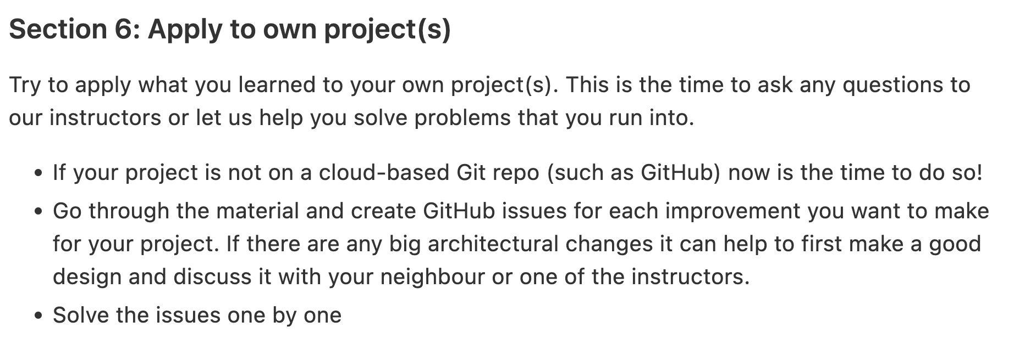
Section 6: Apply learned skills to your own projects
For software to succeed it needs to be managed as well as developed
Notes:
[Who managed to finish the first four sections' material?]
If I could ask Aleks to prepare the breakout rooms
What remaining questions do you have on the material so far?
So last week we had you working together a bit, and the next couple of days' material will continue this theme
Where you'll be working in groups!
So continuing the theme of doing more work together in a group, as a team:
So a lot of the things you've been learning about so far are important skills for working in teams,
and for others within and beyond your team that may reuse your code
Things like using a branch strategy for developing code in GitHub, ensuring correctness with techniques like unit testing, and giving thought to software design and structuring your code architecturally - so it's easier to understand, develop, and maintain
All these things help when developing software collectively
And after the first episode today, it gets a bit more exciting - we'll be looking at bringing these skills together with you working in teams
As well we looking at some new practices that can really help team development
In terms of material, this week will start with how we track issues with software
how we communicate with and around software issues as a team
And how we can use GitHub to manage these issues
Using GitHub project boards to view and organise these issues, again as a team
So after the the first episode it's about assessing the suitability of software for reuse - as a team
So within your zoom breakout rooms you'll act as a team
Pick one of the repositories you've been working on to be a team repository,
And then conduct an assessment of another team's repository, registering issues on their repository as you go
In the follow-up exercises to that, you'll be working on the issues another team has registered on your repository
You'll be using techniques such as effort estimation and prioritisation to work out which issues are most important and what you can achieve given the effort you have available within your team
Once you've done that, the idea is you'll divide up the work amongst yourselves and resolve them with the time remaining - in what's known as a sprint (or a mini-sprint in this case)
Hopefully it'll be fun!
So the key messages from this section are that
It's a good idea to be diligent in selecting software we want to use in our projects
we should take time to determine whether the software we can use is a good fit
Also that requirements effort estimation and prioritisation are key tools that help us maintain focus on what's important for our project, and also what we can achieve
Since there's a bit of solo work first then group exercises, there's a bit of synching-up you'll need to do as a team to work together on the group exercises - so perhaps try to work through the first episode and finish by about (say) 2pm if you can
You'll also need to choose one of your team's repositories to represent your group - you can do this any way you wish!
There's a section in the feedback doc for Section 5 where you can share your repository's URL with another team - the exercise will tell you how to do it, essentially sharing it in a shared Google Doc. I'll share that in the Teams chat after you start.
Here's the shared Google Document: https://docs.google.com/document/d/1dZ3hE-VpJ4QiPMXeYheBMTf1BLDy6IBBfXH2LUG5KkU/edit#
But of course, let us know if you have any questions!
On that note - any questions before we start?
Stewart Macinnes, project manager talking on software lifecycle
Are the breakout rooms ready?
See you later at 15:30!

Slide 76


Congratulations! You have transformed from a simple programmer to a full-grown software engineer!

Slide 77
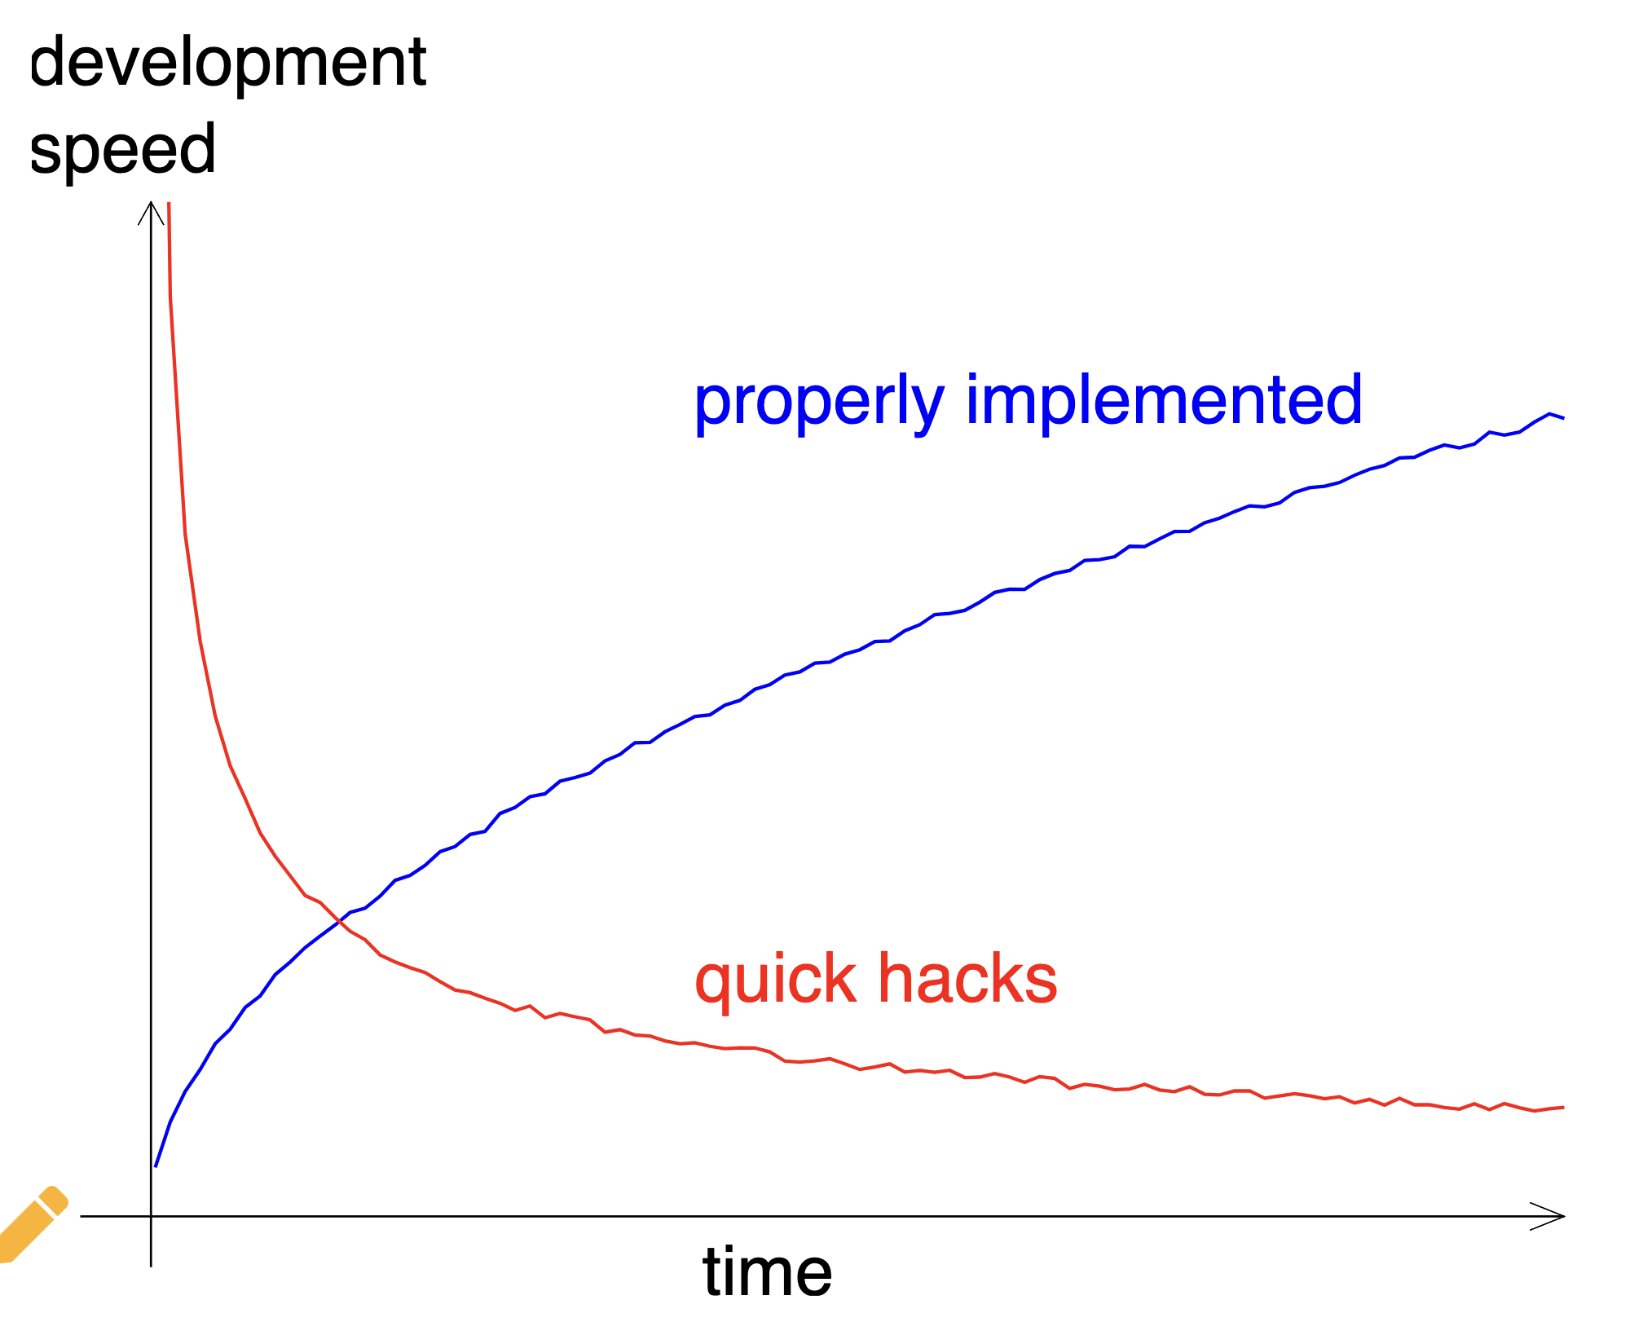
Design
Requirements
Automated testing
Code quality
Linter
Continuous Integration
Packaging
Documentation
Peer review
Project organisation
Feature branching

Slide 78

We can teach you some useful skills, but unfortunately in software engineering experience matters…

Slide 79
Next steps
Apply what you learned in your own projects.
Measure code coverage and code quality, slowly build this up over time.
Self-learning (see collaborative documents for resources)
Read a book
Watch youtube
Online courses and tutorials

Slide 80
What did you learn that is maybe more important than experience?

Slide 81
What did you learn that is maybe more important than experience:
ATTITUDE

Slide 82
Left-over slides from Section 5

Slide 83
Section 5: Managing and Improving Software Over Its Lifetime
Tracking issues, managing team communications and software project planning and management. See how far you get!
Assessing software for suitability
Using issues to record software problems
It's good to be diligent in selecting software we want to use in our projects
Software improvement through feedback
Estimating effort for resolving recorded issues, and prioritisation using MoSCoW
Using a group mini-sprint to organise work on resolving issues
Effort estimation and prioritisation are key tools to maintain development focus on…
What's important for our project
What we can realistically achieve
For software to succeed it needs to be managed as well as developed
Notes:
[Who managed to finish the first four sections' material?]
If I could ask Aleks to prepare the breakout rooms
What remaining questions do you have on the material so far?
So last week we had you working together a bit, and the next couple of days' material will continue this theme
Where you'll be working in groups!
So continuing the theme of doing more work together in a group, as a team:
So a lot of the things you've been learning about so far are important skills for working in teams,
and for others within and beyond your team that may reuse your code
Things like using a branch strategy for developing code in GitHub, ensuring correctness with techniques like unit testing, and giving thought to software design and structuring your code architecturally - so it's easier to understand, develop, and maintain
All these things help when developing software collectively
And after the first episode today, it gets a bit more exciting - we'll be looking at bringing these skills together with you working in teams
As well we looking at some new practices that can really help team development
In terms of material, this week will start with how we track issues with software
how we communicate with and around software issues as a team
And how we can use GitHub to manage these issues
Using GitHub project boards to view and organise these issues, again as a team
So after the the first episode it's about assessing the suitability of software for reuse - as a team
So within your zoom breakout rooms you'll act as a team
Pick one of the repositories you've been working on to be a team repository,
And then conduct an assessment of another team's repository, registering issues on their repository as you go
In the follow-up exercises to that, you'll be working on the issues another team has registered on your repository
You'll be using techniques such as effort estimation and prioritisation to work out which issues are most important and what you can achieve given the effort you have available within your team
Once you've done that, the idea is you'll divide up the work amongst yourselves and resolve them with the time remaining - in what's known as a sprint (or a mini-sprint in this case)
Hopefully it'll be fun!
So the key messages from this section are that
It's a good idea to be diligent in selecting software we want to use in our projects
we should take time to determine whether the software we can use is a good fit
Also that requirements effort estimation and prioritisation are key tools that help us maintain focus on what's important for our project, and also what we can achieve
Since there's a bit of solo work first then group exercises, there's a bit of synching-up you'll need to do as a team to work together on the group exercises - so perhaps try to work through the first episode and finish by about (say) 2pm if you can
You'll also need to choose one of your team's repositories to represent your group - you can do this any way you wish!
There's a section in the feedback doc for Section 5 where you can share your repository's URL with another team - the exercise will tell you how to do it, essentially sharing it in a shared Google Doc. I'll share that in the Teams chat after you start.
Here's the shared Google Document: https://docs.google.com/document/d/1dZ3hE-VpJ4QiPMXeYheBMTf1BLDy6IBBfXH2LUG5KkU/edit#
But of course, let us know if you have any questions!
On that note - any questions before we start?
Stewart Macinnes, project manager talking on software lifecycle
Are the breakout rooms ready?
See you later at 15:30!

Slide 84
Daily schedule
13:00 - 13:05 BST (14:00 - 13:05 CEST) - kick off
13:05 - 15:10 BST (14:05 - 16:10 CEST) - self-learning in breakout rooms
15:10 - 15:30 BST (16:10 - 16:30 CEST) - feedback
15:30 - 16:00 BST (16:30 - 17:00 CEST) - AZ expert talk (Lars Lynne Hansen, Associate Director AI Engineering @ AstraZeneca) and Q&A

